Slide 1
The Evolution of Threat
Assessment and
Management in Healthcare Settings
Kostas A. Katsavdakis, Ph.D., ABPP
Diplomate in Forensic Psychology
Center for Forensic and Clinical Psychology
New York City
kostas@drforensic.com
St. Cloud, Minnesota
September 30th, 2022

Slide 2
Outline of Presentation
Affective and Predatory Modes of Violence
Differences and similarities between Threat and Risk Assessment
Dynamic factors for targeted violence
Implementation of Threat Assessment Management Protocol
Workplace Threat and Risk Assessment
Stalking – Relevant to workplace violence
Relevant Assessment Instruments

Slide 3
U.S. Bureau of Labor Statistics, 2018

Slide 4
The National Center for Victims of Crimes, 2018
(1995-2015)

Slide 5
The National Center for Victims of Crimes, 2018
(1995-2015)

Slide 7


Census of Fatal Occupational Injuries
Bureau of Labor Statistics, 2020 (USDL-21-2145)
Fatalities in healthcare support occupations increased 15.8 percent to 44 fatalities, up from 38 in 2019.

Slide 8
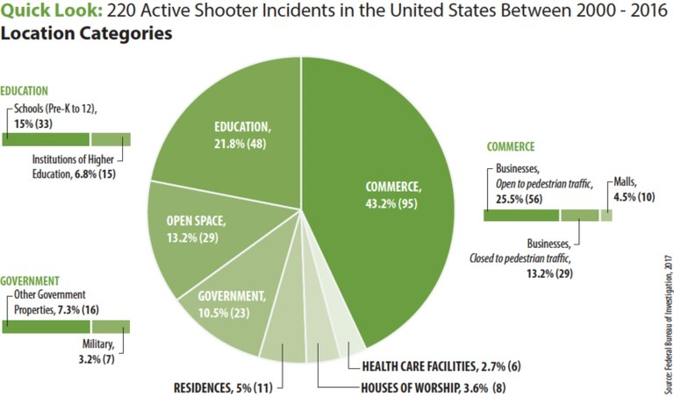

Slide 9
Bureau of Labor Statistics, 2013

Slide 10
Bureau of Labor Statistics, 2013

Slide 11
Bureau of Labor Statistics, 2013

Slide 12
FBI Active Shooter Criteria
Shootings occurring at more than one location
Shootings where the shooter’s actions were not the result of another criminal act
Shootings resulting in a mass illing4
Shootings indicating apparent spontaneity by the shooter
Shootings where the shooter appeared to methodically search for potential victims
Shootings that appeared focused on injury to people, not buildings or objects
Active Shooter Incidents in the United States, 2021, United States Department of Justice, FBI

Slide 13
Active Shooter Incidents in the United States, 2021, United States Department of Justice, FBI

Slide 16
Affective and Predatory
Modes of Violence

Slide 17
What is violence?
An intentional act of aggression toward another human being that physically injures, or is likely to physically injure, that human being.

Slide 18
Affective & Predatory
Modes of Violence
Intense ANS arousal
Subjective experience of emotion
Reactive and immediate violence
Internal or External threat
Goal is threat reduction
Minimal or no ANS
No conscious emotion
Planned and purposeful
No or minimal threat
Many goals

Slide 19
Affective and Predatory (continued)
Rapid displacement of target
Time-limited behavior
Preceded by public posturing
Primarily emotional
Heightened and diffuse awareness
No target displacement
No time limit to behavior
Preceded by private ritual
Primarily cognitive-conative
Focused awareness

Slide 20
Categorizing Aggressive Acts
Affective: “hot, short fuse”
  Impulsive, unplanned, reactive
  Purpose: to reduce a perceived immediate
  “threat” (of abandonment, rejection, etc.)
Predatory: “cold blooded”
  Premeditated, controlled, instrumental, targeted, intended
  Purpose: power, dominance, gratification, revenge, notoriety, control, etc.

Slide 21
Differences and Similarities between Threat and Risk Assessment

Slide 22
Threat Assessment,
Goodrum et al., 2018
“The threat assessment process seeks to evaluate
the likelihood a person will perpetrate “targeted
violence” (i.e., toward a specific person or group), such as an assassination or a school shooting. In schools, threat assessment procedures seek to evaluate a student’s risk of targeted violence and build a safety plan to support the student.” (pp. 123).

Slide 23
Risk Assessment,
Goodrum et al., 2018
“A risk assessment evaluates the risk and protective
factors present in a person and evaluates the risk for general and specific forms of violence (e.g., intimate partner violence, stalking).” (pp. 123).

Slide 24
Risk v. Threat Assessment (Meloy, et al., 2011)
Violence risk assessment has older provenance
Risk assessment focuses on probability of violence and estimated for an individual based upon his/her comparison to a known group
Typically a history of violence
Classification of low, medium or high risk

Slide 25
Risk v. Threat Assessment (Meloy, et al., 2011)
Threat assessment focuses on targeted violence by a subject of concern and encompasses a behavioral and profiling focus.
Person of focus may have no history of violence.

Slide 26
Differences between TA and RA
Operational context
Dynamic emphasis
Idiographic (case-driven) approach
Very low base rates
Risk management rather than prediction
Subject and potential victim
Predatory (instrumental, intended) violence
Likely urgency

Slide 27
Threat Assessment Model
We don’t focus on predicting what the subject will do in the future. We focus on managing risk for what subject is doing now.
We are not able to anticipate threats with certainty (Meloy, et al., 2014).
We attempt to implement sound practices to identify and intervene with subjects as early as possible on the path toward violence (Cornell, 2010).

Slide 28
Threat Assessment Model
Generally posits that targeted violence is deliberate, planned and well thought out versus expressive/reactive violence
The progress occurs from ideation >> planning >> acquisition>> implementation (Deisinger et al., 2008).

Slide 29
Threat Assessment Model
Pathway to violence is not linear
Iterative such that the person can cycle between the pathway, contingent upon information gathered, increased desperation and monitoring.

Slide 30
Threat Assessment Model
De-emphasizes:
  Psychiatric Diagnoses
  Static variables
  Communicated threats

Slide 31
Implication for Threat Assessment,
(Vossekuil, Fein and Berglund, 2015)
Targeted violence is the end result of an understandable, and often time discernible, process of thinking and behavior.
Targeted violence stems from an interaction among the individual, the situation, the setting, and the target.
An investigative, skeptical, inquisitive mind-set is critical to successful threat assessment.

Slide 32
Implication for Threat Assessment,
(Vossekuil, Fein and Berglund, 2015)
Effective threat assessment is based on facts rather than on characteristics or “traits.”
An integrated systems approach should guide threat assessment inquires and investigations
The central question in a threat assessment investigation or inquiry is whether her person of interest poses a threat, not whether the person of interest made a threat.

Slide 33
What are vulnerabilities within threat assessment?
Inductive (abductive) reasoning
  One moves from particular facts about a case to a general principal
Availability bias
  Importance is judged by ease and emotional charge with which it comes to mind, not actual probability
Predictable world bias
  Tendency to see events as more predictable than they were (hindsight bias) or are (foresight bias)

Slide 34
Confirmatory Bias—how we seek to protect our beliefs
We notice facts to support our beliefs
We overlook facts that don’t
We seek information to support our beliefs
We give greater weight to such information
We accept at face value such information
We are better able to remember such information

Slide 35
Additional Biases
Google Bias
  Tendency to not remember information is easily found online – (cell phones)
Ikea Effect
  Tendency to overvalue something that we put together
Cheerleader Effect
  Perception that people look more attractive in a group that in isolation

Slide 36
The low base rate dilemma
Predictive attempts will result in too many false positives due to low base rate for targeted violence
The Paradox: we will never know the violent acts we prevented

Slide 37
Dynamic Factors for
Targeted Violence

Slide 38
Warning Behaviors (Meloy, Hoffmann, Guldimann & James,
BS&L, 2012; 30:256-279
Pathway
Fixation
Identification
Novel aggression
Energy burst
Leakage
Directly communicated threat
Last resort behavior

Slide 39
Warning Behaviors
They are accelerants—focus on accelerating change
Patterns of behavior rather than individual risk factors: pattern analysis
Appear to correlate with targeted violence, but do they predict?

Slide 40
Pathway warning behavior
Any behavior that is part of research, planning, preparation, or implementation of an attack (Fein & Vossekuil, 1998, 1999; Calhoun & Weston, 2003)

Slide 41
Pathway to Targeted or Intended Violence
Adapted with permission from F.S. Calhoun and S.W. Weston (2003). Contemporary threat management: A practical guide for identifying, assessing and managing individuals of violent intent. © 2003 F.S. Calhoun and S.W. Weston. All rights reserved.
Attack
final acts
Probing & Breaches
Pre-attack Preparation
Escalation
Research & Planning the Attack
De-Escalation
decision
Violent Ideation
The “Grievance”
Notes:
41

Slide 42
Grievance
Loss
Humiliation
Anger
Blame

Slide 43
Fixation warning behavior
    Any behavior that indicates an increasingly pathological preoccupation with a person or a cause (Mullen et al., 2009). It is measured by: a) increasing perseveration on the person or cause; b) increasingly strident opinion; c) increasingly negative characterization of the object of fixation; d) impact on the family of the object of fixation, if present and aware; e) angry emotional undertone. It typically causes deterioration of social and occupational functioning.

Slide 44
Characteristics of Identification
Meloy, Mohandie, Knoll & Hoffman, 2015
Pseudo-commando
Warrior mentality
Close association with weaponry, law enforcement, military paraphernalia
Identify with other attackers or assassins
Become an agent to advance a particular cause or belief system

Slide 45
Weapon Access and Background
What is the subject’s familiarity with weapons?
Do they possess weapons?
Do they seek out weapons?
Frequency of attending gun shows
Do they collect/stockpile ammunition
Do they carry/conceal weapons?
Have they made recent purchases?

Slide 46
Weapon Access and Background
Internet searches for weapons?
Does the subject of interest purchase parts from internet sites “swap meet” sites; etc., craigslist
Is the person purchasing attire/clothing related to identification or “pseudo-commando” goals
Does the subject of interest have relatives who possess guns?

Slide 47
Novel aggression warning behavior
    An act of violence which appears unrelated to any targeted violence pathway warning behavior which is committed for the first time. Such behaviors may be utilized to test the ability (de Becker, JACA) of the subject to actually do a violent act, may be a measure of response tendency, the motivation to act on the environment (Hull, 1952), a behavioral tryout (MacCulloch, Snowden, Wood & Mills, 1983), or proof of kill (G. Deisinger, personal communication, 2011).

Slide 48
Energy Burst (cont’d)
Unable to purchase ammunition at first Walmart, purchases 9 mm full metal jacket ammo and diaper bag at 0727
Stopped by police officer for running a red light
Confronted by father at home, runs away
Returns to Circle K, gets a cab, goes to supermarket where he insists on getting correct change for cab ride

Slide 49
Leakage warning behavior
    The communication to a third party of an intent to do harm to a target through an attack (Meloy & O’Toole, Behavioral Sciences and the Law, 29:513-527, 2011).

Slide 50
Leakage Warning Behaviors
1990 to 2014, 58% engaged in some form of leakage (Silver, Horgan, & Gill, 2018)
2000 to 2013 FBI study of active shooters, 56% openly expressed their violent thoughts or intent prior to attacking (Silver, Simons, & Craun, 2018)

Slide 51
Leakage Warning Behaviors
Research suggests - people are often hesitant to report potential mass shooters to law enforcement, even if they observe concerning behavior (Madfis, 2014a; Silver, Simons, & Craun, 2018)
“bystander intervention” increases sense of responbility on self
Reporting of stranger is easier than known persons

Slide 52
Last resort warning behavior
    Evidence of a violent “time/action imperative” (Mohandie & Duffy, 1999). Increasing desperation or distress through declaration in word or deed, forcing the individual into a position of last resort. There is no alternative other than violence, and the consequences are justified (de Becker, 1997). The subject feels trapped (S. White, personal communication).

Slide 53
Last resort warning behavior
    Evidence of a violent “time/action imperative” (Mohandie & Duffy, 1999). Increasing desperation or distress through declaration in word or deed, forcing the individual into a position of last resort. There is no alternative other than violence, and the consequences are justified (de Becker, 1997). The subject feels trapped (S. White, personal communication).

Slide 54
Directly communicated threat warning behavior
    The communication of a direct threat to the target or law enforcement beforehand. A threat is a written or oral communication that implicitly or explicitly states a wish or intent to damage, injure, or kill the target, or individuals symbolically or actually associated with the target.

Slide 55
Implementation of Threat Assessment and Management

Slide 56
There is no cook-book approach!

Slide 57
Threat Assessment and Management
Goals include:
  Piece together information
  Redirect subject of interest’s motion away from the path toward violence.
  Engage in a non-adversarial manner.
  Involves engaging subject of interest.
  Casts a wide net.
  Behavior of team does not exacerbate the situation.

Slide 58
Threat Management Team Make-Up
Case Manager/Team Leader
Administrative Staff
Teachers/Counselors
Law Enforcement - Community
Security
  Liaison with Police

Slide 59
Threat Management Team Make-Up
External referral sources for Threat Assessment
Mental Health Professional
Attorney
  In-House/Retained externally if needed
Ad-hoc members, as needed

Slide 60
Threat Assessment Team
(Van der Meer and & Diekhuis, 2014)
Each person/member on the team should have an identified task/role
Documentation guidelines
Legal issues
Developing timelines
  Constantly monitored and logged/altered with specific dates/times
Managing information
  Ensure validity, reliability
  Maintain position of healthy skepticism
Referral source educated about providing all information
  silo effect

Slide 61
Threat Assessment/Interview
(Van der Meer and & Diekhuis, 2014)
Interview – Tool for Gathering Information
  Reasons for interviewing
    Collect reliable information on risk and protective factors
    Substantiate or contradict prior identified risk and protective factors
    Finding collateral information from interviewee; examine other sources
    Gather understanding of what is driving the interviewee’s behavior
    Provide information on what the interviewee can and cannot do – violate law
    Most persons appear willing to talk

Slide 62
Threat Assessment/Interview
(Van der Meer and & Diekhuis, 2014)
Interview – Tool for Gathering Information
  Understanding the Interviewee
    Explain at the outset the reason and importance for the interview
    Utilize objective, neutral, non-judgmental stance
    See the situation through their eyes
    Persons who demonstrate paranoid delusions or have paranoid personality traits – reluctant to participate in interview process
    Home visit, or within their environment, if safe and permissible

Slide 63
Threat Assessment/Interview
(Van der Meer and & Diekhuis, 2014)
Interview – Tool for Gathering Information
  Preparing for the interview
    Detailed knowledge of facts, case and timeline
    Identification of relevant behavioral and personality features of interviewee
    Cultural implications for assessment (Hart, 2016; Olver, 2016; Weiss and Rosenfeld, 2012)
    Ensure personal safety during interview
    Awareness that personal safety is vulnerable if questions are aimed at their personal frustration, stressors and other negative matters
    Possibly have two interviewers, if available
    Tape recording to ensure accuracy – can be explained that it is to prevent confusion about what they said, although most persons are very reluctant to consent to recording

Slide 64
Threat Assessment
Cultural Considerations (Hart, 2016)
Identify potential diversity issues that may bias evaluator.
When potential diversity issues exist, evaluator is responsible for education about impact the diversity will have on assessment process (lit. review, colleagues).
Decline case if do not have requisite skills; decline to use instrument/assessment procedures, cautionary statements, identifying limitations.

Slide 65
Threat Assessment-Cultural Considerations (Weiss and Rosenfeld, 2012)
Consider one’s own cultural competence prior to accepting a referral.
Level of acculturation should be considered when administering psychological tests to an individual from another culture.
If interpreters are used, they must be objective, well trained, and provide a verbatim translation of the evaluatee’s responses.

Slide 66
Threat Assessment-Cultural Considerations (Weiss and Rosenfeld, 2012)
Evaluators must consider the reliability and validity of measures used with respect to an evaluatee’s group membership.
The evaluator must acknowledge when the psychometric challenges for use of a measure are insurmountable. If the lack of reliability and validity data prohibit the use of a measure, the evaluator may be forced to rely on other sources (e.g., clinical and collateral interviews, medical and criminal justice records).

Slide 67
Identify risk and threat factors
How they manifest in person
How each is relevant
Assessment
Communication
Management
& Treatment
Low, moderate, high
Intensity of Management
Tailored interventions based on risk and threat factors
Application of risk and threat management strategies
Reassessment on regular intervals

Slide 68
Strategy Planning
Monitoring
Surveillance or repeated assessment
Treatment
Rehabilitation, further assessment
Victim Safety Planning
Enhanced security measures, resources for identified targets
Supervision
Imposition of controls, restriction of movement

Slide 69
Developing Scenarios
Douglas, et al., 2013
Consider all past violence, not just recent
Escalation, including worst case scenario
Assess change in motivation, victim selection and behavioral topography
Improvement, including desistance or best case scenario

Slide 70
Scenario Planning,
Douglas, et al., 2013
Develop scenarios
Evaluate scenarios
Which “possible futures” most deserve attention?
Use scenarios to plan
Which strategies, tactics, and logistics are needed?
What are the “possible futures?”

Slide 71
Hierarchy of Threat Management
(Palarea & Van Horn, 2010)
Incarceration/Jail
Arrest
Hospitalization
Restraining Order/Protection Order
Refer for outpatient mental health counseling
Administrative actions
Ecological/physical measures
Leverage subject of interest’s social network
Notify subject of interest boundaries/consequence
Notify subject of interest about safety measures

Slide 72
Target Hardening
Ecological and situational controls
  Reduce opportunity for strangers or subject of interest to access location.
  Availability to access/exits.
  Communication device accessibility.
  Law enforcement presence.
  CCTV systems/monitoring.

Slide 73
Ongoing Training
Technical vs. Adaptive Solutions
Goodrum, et al., 2018
Technical solutions are addressed with few small adjustments by one authority and within organizational boundaries (e.g., metal detector, video surveillance system).

Slide 74
Ongoing Training
Technical vs. Adaptive Solutions
Goodrum, et al., 2018
Adaptive solutions include number ongoing TA trainings, assessing more students for threats, and increasing the number of indicators on the TAT screener.

Slide 75
Technical vs. Adaptive Solutions
Goodrum, et al., 2018
Adaptive solutions require multiple authorities, crossover organizational boundaries (e.g., schools, mental health, and criminal justice) but elicit emotional responses, and face resistance.
Adaptive solutions require that school officials share information to promote a “culture of safety,” adopt continuous improvements to threat assessment, monitor quality of threat assessment and engage in safety planning implementation process.

Slide 76
Workplace Risk and Threat Assessment

Slide 77
Bureau of Labor Statistics
Violence is vastly underreported.
Survey of 4,738 Minnesota nurses found that only 69% of physical assaults and 71 % of non-physical assaults were reported to a manager (Gerberich, et al., 2004).
One medical center found that half of verbal and physical assaults by patients against nurses were never reported in writing (ASIS, 2011).

Slide 78
Indicators of Workplace Violence, 2019
(July 2022, U.S. Department of Justice, Office of Justice Programs; Bureau of Justice Statistics; NCJ 250748; NIOSH 2022-124)
Fatal and nonfatal workplace violence.
Workplace homicide as fatal violence against persons at work or on duty or fatal violence that was work-related. Nonfatal workplace violence is defined as violent acts (including physical assaults and threats of assault) directed toward persons at work or on duty, or nonfatal violence that was work-related (such as an attack on a coworker away from work over a work-related issue). This includes rape or sexual assault, robbery, aggravated assault, and simple assault.
Five federal data collections:
  National Crime Victimization Survey
  National Electronic Injury Surveillance System - Occupational Supplement
  National Vital Statistics System
  Center of Fatal Occupational Injuries
  Survey of Occupational Injuries and Illness Case and Demographics

Slide 79
Indicators of Workplace Violence, 2019
(July 2022, U.S. Department of Justice, Office of Justice Programs; Bureau of Justice Statistics; NCJ 250748; NIOSH 2022-124)
Total: 17,865 workers were victims of workplace homicides from 1992 to 2019
Workplace homicides have fallen more than 50% from a high of 1,080 in 1994.
Nonfatal workplace violence, 2015–19
  During 2015–19, workers in corrections occupations had the highest average annual rate of nonfatal workplace violence of all the occupations examined.
  Strangers committed about half (47%) of nonfatal workplace violence.
  Female victims of nonfatal workplace violence were more likely than male victims to know the offender.
  On average, 1.3 million nonfatal violent crimes in the workplace occurred annually.
  Fifteen percent of victims of nonfatal workplace violence reported severe emotional distress due to the crime.

Slide 80
Indicators of Workplace Violence, 2019
(July 2022, U.S. Department of Justice, Office of Justice Programs; Bureau of Justice Statistics; NCJ 250748; NIOSH 2022-124)

Slide 81
Indicators of Workplace Violence, 2019
(July 2022, U.S. Department of Justice, Office of Justice Programs; Bureau of Justice Statistics; NCJ 250748; NIOSH 2022-124)

Slide 82
Indicators of Workplace Violence, 2019
(July 2022, U.S. Department of Justice, Office of Justice Programs; Bureau of Justice Statistics; NCJ 250748; NIOSH 2022-124)

Slide 83
Types of Workplace Violence
Type I: Perpetrator has no association with the workplace or employees.
  Individual with criminal intent commits armed robbery.

Slide 84
Types of Workplace Violence
Type II: Perpetrator is a customer or patient of the workplace or employees.
  Intoxicated patient punches nurse’s aide.

Slide 85
Types of Workplace Violence
Type III: Perpetrator is a current or former employee of the workplace.
  Recently terminated employee assaults former manager/employees.

Slide 86
Types of Workplace Violence
Type IV: Perpetrator has a personal relationship with employees, none with the workplace.
  Ex-husband stalks and assaults ex-wife at her place of work.

Slide 87
Behavioral Threat Assessment Healthcare System, Purcell, 2018
Threat assessment teams function best when they are embedded in a comprehensive violence prevention program.
The gold standard in threat assessment combines standardized assessment and inter-disciplinary professional discussion; abandon either at your peril.

Slide 88
Behavioral Threat Assessment Healthcare System, Purcell, 2018
Threat assessment teams are strongest when they include diverse voices, and when every member feels empowered to ask questions and to share their perspective.
A threat is in the eye (and the body) of the beholder. It is no less real, and no less significant, for that fact.

Slide 89
Behavioral Threat Assessment Healthcare System, Purcell, 2018
Threat assessment is (mostly) evidence-based, but threat response is (mostly) values-driven; choose those values consciously and wisely.
Patient record flags and other warning systems do stigmatize; they are also necessary. Apply with extreme caution.

Slide 90
Behavioral Threat Assessment Healthcare System, Purcell, 2018
Stay creative and be comprehensive when evaluating threat management options.
Always close the loop with the people impacted by your actions—including the reporter and the clinical team— even if the decision is to do nothing but watch and wait.

Slide 91
Behavioral Threat Assessment Healthcare System, Purcell, 2018
Your threat management plans will not please everyone, but you must make a good faith effort to help people understand why you recommend the chosen course of action.
All assessments and actions are provisional; mistakes will be made and reality will change.

Slide 92
Risk Variables for Workplace Violence
There is no mathematical formula for interpreting the variables
They are weighed and integrated into a total picture in individual cases
Remember: focus on dynamic factors in case management

Slide 93
Red Flag Indicators
Motives for Violence
Homicidal Ideas, Fantasies, or Preoccupation
Violent Intentions and Expressed Threats
Weapons Skill and Access
Pre-attack Planning and Preparation

Slide 94
Motives for Violence
Risk Indicators:
Evidence of felt motive to act violently as a legitimate means to address a grievance or achieve an objective
For example, to:
  seek revenge
  gain “justice”
  end pain
  gain notoriety
  bring attention to or solve a problem
If these not apparent, what is plausible explanation for the behaviors of concern?

Slide 95
Homicidal Ideas, Violent Fantasies or Preoccupation
Risk Indicators:
Homicidal ideation or thoughts, especially toward anyone in the workforce
Preoccupation with violent themes, fantasies, weapons, or violent groups
Approval of violence, especially workplace violence
identification with perpetrators of violence.

Slide 96
Violent Intentions and Expressed Threats
Risk Indicators:
Any threats, specific plans, or expressed intentions to harm any members of the workforce (spoken, written, electronic, or symbolic)
A time imperative may indicate a more imminent intention to act.

Slide 97
Weapons Skill and Access
Risk Indicators:
Firearms or weapons possession and skill
Evidence of bringing weapons to the workplace

Slide 98
Pre-Attack Planning and Preparation
Risk Indicators:
Preparations for violence
Planning and/or practice
Increased weapons acquisition
Access to potential targets
Research to increase knowledge of targets’ whereabouts
Actions to increase access to targets.

Slide 99
Stalking or Menacing Behavior
Risk Indicators:
Stalking
Fixation
Current case-related pattern of fear-inducing harassment
Covert or deceptive contact with a victim
Probing of victim’s physical boundaries
Defiance of workplace rules or authority
Security breaches or attempts

Slide 100
Current Job Problems
Risk Indicators:
Recent or likely termination
Significant performance, conduct, or job status issues
Pattern of under- or unemployment over a period of months or years

Slide 101
Extreme Job Attachment
Risk Indicators:
Strong personal and emotional attachment to job or career path
Significant discrepancy between the employee’s and the employer’s view of his or her work contribution

Slide 102
Loss, Personal Stressors and Negative Coping
Risk Indicators:
Observable stress, desperation, despair, or humiliation in reaction to a significant loss, death, rejection or setback
For example:
  death of a family member
  break-up of a marriage or relationship
  loss of status, financial resources, property, or health
  failed civil actions
  generally very poor coping ability when stressed.

Slide 103
Entitlement and Other Negative Traits
Risk Indicators:
Strong sense of entitlement and self-centeredness
Highly defensive
Blaming of others
Intolerant
“Black or white” thinking
Preoccupation with felt insults
Fixation
Holds grudges
Vindictive

Slide 104
Lack of Conscience and Irresponsibility
Risk Indicators:
Callous disregard for or exploitation of others
Lack of remorse for wrongdoing
Habitual lying
Habitual pattern of violating work policies or laws

Slide 105
Anger Problems
Risk Indicators:
Angry outbursts
“Ready to explode” appearance
Impulsive reactions to frustration
Physical displays of anger
  e.g., throwing objects, property destruction, vandalism
Pattern of bullying, belligerence, intimidation
Expression of anger leads to noteworthy fear in others
Escalation in expressions of anger over days or weeks
OR… Sudden absence of chronic anger!

Slide 106
Suicidality
Risk Indicators:
Notably depressed mood
Strong feelings of hopelessness or “nothing to lose”
Suicidal ideas or actions, including history of attempts
Anger associated with depressed mood or suicidal feelings
Noncompliance with recommended mental health treatment for depression
Exception to depression: suicide stemming from severe narcissism

Slide 107
Irrational Bizarre Thinking (Psychosis)
Risk Indicators:
Highly irrational fear of being harmed or attacked
  especially if linked to an intention to attack perceived enemies
Persecutory or delusional beliefs or hallucinations
  especially if linked to an intention to attack perceived enemies
Highly elevated, grandiose mood
Impulsive behavior
Agitation
Anger or acts of violence associated with any of the above
Noncompliance with mental health treatment for any of the above

Slide 108
Substance Abuse
Risk Indicators:
Alcohol abuse or dependence
Amphetamine/cocaine abuse or dependence
Other drug abuse or dependence
Anger expression and/or violence associated with alcohol or drug abuse or dependence
Recent history of treatment noncompliance for drug or alcohol problems

Slide 109
Isolation
Risk Indicators:
Active avoidance of social and intimate bonds
Increasing preference for isolation

Slide 110
History of Violence, Criminality, and Conflict
Risk Indicators:
History of violence
  especially recent, frequent, or severe
Denial or minimization of known violence history
History of being restrained by protective orders or violating protective orders
History of nonviolent criminality, interpersonal conflict, filing grievances or litigiousness
Childhood exposure to violence

Slide 111
Domestic/Intimate Partner Violence
Risk Indicators:
History of partner assault, escalation, harassment, surveillance, or stalking
History of assaulting previous partners
Jealousy, especially toward work relationships
Recent separation and/or ex-partner in a new relationship, especially with a co-worker
Threatening contacts with partner in the workplace
Romantic triangle involving subject and two other co-workers

Slide 112
Situational & Organizational Contributors to Violence
Risk Indicators:
Presence of negative situational influences such as subject’s family, peer group, or community support for violence
Supervisor or co-worker provocation
Notably demanding workload

Slide 113
Situational & Organizational Contributors to Violence
Risk Indicators:
Poor physical work environment
Negative management practices or adversarial management-workforce relationship
Lack of management violence-prevention knowledge and protocol
Others’ denial of subject’s violence potential.

Slide 114
Organizational Impact of
Real or Perceived Threats
Evaluate also the fear and disruption created by threat scenarios
  how they impact the workplace
  how they influence case management
  not necessarily related to objective level of risk
We are implicitly managing fear in conducting assessments and responses

Slide 115
Protective Factors against
Workplace Violence
Resilience
Positive and supportive family or intimate attachments
Pro-social attachments and involvement
Genuine remorse regarding their fear-inducing behavior
Genuine respect for authority;

Slide 116
Protective Factors against
Workplace Violence
Positive or appropriate response to limit-setting, or negotiating
Appropriate help-seeking for problems (legal advise, mental health treatment, career guidance, spiritual support);
Motivation to avoid legal consequences for threatening or criminal behavior.

Slide 117
Suicide in the Workplace
Static variables
Dynamic variables
Intent – the ultimate risk factor
Assessment challenges
Suicide-homicide link
  If the risk for one is apparent, look for risk of the other

Slide 118
Suicide Statistics
Tenth leading cause of death in the U.S.
  41,149 in 2013
  Average 113 per day
Men 4 times more likely than women to suicide
Women attempt more often than men
Men complete suicide more often than women
Men over 65 highest rate of suicide
Women between 25-64 highest rate
Risk peaks in young adulthood for Hispanic, African American and Native American males
*National Center for Disease Control: Fatal Injury Reports 2013

Slide 119
Methods - Suicides
Firearms
  most frequent means
  method of choice for men
Poisoning
  method of choice for women
  most frequent non-fatal means
Additional means
  overdose
  suffocation
  cutting

Slide 120
Reginald Harris, "Suicide in the workplace," Monthly Labor Review, U.S. Bureau of Labor Statistics, December 2016.

Slide 121
Reginald Harris, "Suicide in the workplace," Monthly Labor Review, U.S. Bureau of Labor Statistics, December 2016.
(2011-2013)

Slide 122
Suicide and Work
Work-related suicides were 8 percent higher in 2013 than in 2012*
Workplace homicides were 16 percent lower*
Suicide follows 30 to 50% of workplace grudge homicides**
*National Census of Fatal Occupational Injuries Summary, 2013
** Various sources

Slide 123
Suicide and Work
94% of workplace suicides committed by men in 2008 (236 of 251)
36% by age group 45-54 (highest)
78% white workers.
52% gunshot wounds: 130 suicides
Gunshot wounds increased 48% from 2007 to 2008
31% asphyxiations/strangulations/suffocation
79% in private industry
*Census of Fatal Occupational Injuries Summary, 2013

Slide 124
Reginald Harris, "Suicide in the workplace," Monthly Labor Review, U.S. Bureau of Labor Statistics, December 2016.

Slide 125
An Inherent and Core Issue
The more serious the intent, the more the likelihood of secrecy
Making assessment and intervention more challenging

Slide 126
Especially Tough Calls
To intrude or not to intrude
The “dangling comment”
Welfare checks
Notifying treatment providers
Communication with stakeholders in general

Slide 127
Motivation for Suicide
Solution to problems
Escape
Despair
Guilt
Spare loved ones
Fantasized reunion with loved ones
Revenge and omnipotent control
It’s almost always about pain

Slide 128
General Risk Indicators - Suicide
Threats of suicide
Profound feelings of sadness, despair and loss
Lack of interest in the future
Self destructive activity
Tunnel vision
Irritable, hostile and agitated behavior
Self hate and blame
Putting affairs in order
Farewell to loved ones

Slide 129
General Risk Indicators - Suicide
Securing and/or possessing lethal means
Significant personal loss
Severe depression/anxiety
Alcohol and/or other drug abuse
Irrational thoughts and statements
Social isolation
Unemployment
Brain injury or disorder
Serious illness, especially with chronic pain

Slide 130
Screening for Lethality
Thoughts/plan
Means/access
History of attempts
Stressors
Mental disorders/substance abuse
Physical illness
Trauma history
Reasons not to commit suicide
Coping ability
Social support

Slide 131
Relevant Work Factors
RIF
Termination
Any other potential adverse job action
  Negative evaluation
  Initiation of performance improvement plan
  Reorganization

Slide 132
Potential Indicators
Workplace Suicide
Verbal statements
Decrease in productivity or attendance
Safety violations/dangerous behavior
Isolation from workgroup
“Putting work affairs in order”
Excessive self blame/criticism
Must consider these in the context of other factors, stressors and losses

Slide 133
Suicide and Workplace Homicide
Suicidal employees are not a homicide risk per se
Red flag:
  suicidal ideation/signs paired with anger and blame directed at the workplace
At least half of WPV perpetrators end the violence with suicide
  very rare event
  no place is immune
Suicide/homicide link should always be explored

Slide 134
Scenarios and Involvement Thresholds
Appropriately Private
  Employee seeks private help, you never know, no work related issue
Semi-private
  Employee seeks help thru a management resource, no clear work related issue
Complex semi-private
  ADA issues require employer involvement
Resistant – No direct workplace impact
  “Signs” observed, no significant workplace impact, employee resists
Resistant – Workplace Impact
  “Signs” observed, workplace impacted, employee resists
Risk of Harm to Others
  Suicidal-homicidal indicators, you know and must intervene

Slide 135
Assessment and Action Options
Screening-Triage: internal
Decision tree of communication
Designated persons to exchange information
Crisis intervention by mental health professional/law enforcement
Indirect Professional Assessment
  using the data available to formulate hypothesis of risk and viable options at a given point in time
Direct Professional Assessment
  face-to-face interview plus all other data.
  especially when there is possible risk to others
Ongoing professional case consultation
“When in doubt, confer”

Slide 136
Treatment Options Overview
Hospitalization
Outpatient psychotherapy
Medication
Social support
Life and work changes and reasonable accommodation

Slide 137
Stalking

Slide 138
“Every move you make, every bond you break
Every step you take I'll be watching you…”

Slide 139
Minnesota’s Anti-Stalking Law 2018
609.749§ Subdivision 1. As used in this section, "stalking" means to engage in conduct which the actor knows or has reason to know would cause the victim under the circumstances to feel frightened, threatened, oppressed, persecuted, or intimidated, and causes this reaction on the part of the victim regardless of the relationship between the actor and victim.

Slide 140
Minnesota’s Anti-Stalking Law 2018
Subd. 6.Mental health assessment and treatment.
(a) When a person is convicted of a felony offense under this section, or another felony offense arising out of a charge based on this section, the court shall order an independent professional mental health assessment of the offender's need for mental health treatment. The court may waive the assessment if an adequate assessment was conducted prior to the conviction.

Slide 141
Stalking – Base Rates
  Epidemiology (Aggression and Violent Behavior, Spitzberg, 2007)
    8 – 32% women victimized during lifetime
    2 - 13% men victimized during lifetime
    Range varies because of how stalking is defined; if pursuit is used rather than stalking, higher rates are reported

Slide 142
Stalking Victims in the United States – Revised
September 2012*
During 12-month period, estimated 1.5% of persons age 18 or older were victims of stalking.
Percentage of stalking victims was highest for individuals who were divorced or separated (3.3%), compared to those married, never married, or widowed.
About 7 in 10 stalking victims knew their offender in some capacity.
A greater percentage of females were stalked than males; however, females and males were equally likely to experience harassment.
*U.S. Department of Justice Office of Justice Programs Bureau of Justice Statistics, NCJ 224527

Slide 143
Stalking Victims in the United States – Revised
September 2012

Slide 144
Stalking Victims in the United States – Revised
September 2012

Slide 145
National Intimate Partner and Sexual Violence Survey, Data Brief, November 2018*
Nearly 1 in 6 women (16.0%, or 19.1 million) in the U.S. were victims of stalking at some point in their lifetime.
About 1 in 17 (5.8% or 6.4 million) men in the U.S. were victims of stalking at some point in their lifetime.
*Smith, S.G., Zhang, X., Basile, K.C., Merrick, M.T., Wang, J., Kresnow, M., Chen, J. (2018). The National Intimate Partner
and Sexual Violence Survey (NISVS): 2015 Data Brief – Updated Release. Atlanta, GA: National Center for Injury Prevention
and Control, Centers for Disease Control and Prevention.

Slide 146
National Intimate Partner and Sexual Violence Survey,
Data Brief, November 2018

Slide 147
National Intimate Partner and Sexual Violence Survey,
Data Brief, November 2018

Slide 148
National Intimate Partner and Sexual Violence Survey,
Data Brief, November 2018

Slide 149
National Intimate Partner and Sexual Violence Survey *
Lifetime Prevalence of Stalking Victimization by Any Perpetrator by State of Residence
U.S. 16.2% (Total = 19,327,00)
  Minnesota, 18.4%
Kentucky, 24.7%
Nevada, 24.4%
Alabama, 24.1%
New Mexico/Oklahoma, 22.3%
Utah, 21.1%
* Black, M.C., Basile, K.C., Breiding, M.J., Smith, S.G., Walters, M.L., Merrick, M.T., Chen, J., & Stevens, M.R. (2011). The National Intimate Partner and Sexual Violence Survey (NISVS): 2010 Summary Report. Atlanta, GA: National Center for Injury Prevention and Control, Centers for Disease Control and Prevention.

Slide 150
Stalking - Victim Base Rates
Victims
  75% of victims are women, (Spitzberg, 2002)
  81% of victims are women (Mohandie, et. al., 2006)
  25% of victims are men, (Spitzberg, 2002)
Majority of cases, perpetrator is known to victim:
  Intimate, 50% (Mohandie, et. al., 2006)
  Former intimates, 50% (Spitzberg, 2002)
  Ex-intimates, 34.5% (McEwan, 2009)

Slide 151
Stalking – Base Rates
  Epidemiology (Aggression and Violent Behavior, Spitzberg, 2007)
    8 – 32% women victimized during lifetime
    2 - 13% men victimized during lifetime
    Range varies because of how stalking is defined; if pursuit is used rather than stalking, higher rates are reported

Slide 152
Stalking Victims in the United States – Revised
September 2012*
During 12-month period, estimated 1.5% of persons age 18 or older were victims of stalking.
Percentage of stalking victims was highest for individuals who were divorced or separated (3.3%), compared to those married, never married, or widowed.
About 7 in 10 stalking victims knew their offender in some capacity.
A greater percentage of females were stalked than males; however, females and males were equally likely to experience harassment.
*U.S. Department of Justice Office of Justice Programs Bureau of Justice Statistics, NCJ 224527

Slide 153
Stalking Victims in the United States – Revised
September 2012

Slide 154
Stalking Victims in the United States – Revised
September 2012

Slide 155
Stalking - Victim Base Rates
Victims
  75% of victims are women, (Spitzberg, 2002)
  81% of victims are women (Mohandie, et. al., 2006)
  25% of victims are men, (Spitzberg, 2002)
Majority of cases, perpetrator is known to victim:
  Intimate, 50% (Mohandie, et. al., 2006)
  Former intimates, 50% (Spitzberg, 2002)
  Ex-intimates, 34.5% (McEwan, 2009)

Slide 156
Mullen Typology (Am J Psychiatry, 1999, 2000, 2009)
Resentful
Rejected (most violent and longest duration)
Intimacy Seekers (longest duration)
Incompetent
Predator (most violent and sexual)
  Mean age 31-41 years, 69-100% males

Slide 157
Mullen Typology (Am J Psychiatry, 1999, 2000, 2009)
Resentful
  Perception of being mistreated, disrespected
  Victim of being humiliated
  Victims typically acquaintances or strangers
  Initial motivation can be revenge, but mental health symptoms such as paranoia can be present

Slide 158
Mullen Typology (Am J Psychiatry, 1999, 2000, 2009)
Rejected
  Occurs in the context of a breakdown of a relationship
  Potential for violence is higher
  Want to enact revenge and/or reconcile relationship

Slide 159
Mullen Typology (Am J Psychiatry, 1999, 2000, 2009)
Intimacy Seekers
  Arises in the context of loneliness or seeking out partnership
  Presence of mental illness is common
  Possible delusional beliefs about victim

Slide 160
Mullen Typology (Am J Psychiatry, 1999, 2000, 2009)
Incompetent Suitor
  Arises in the context of loneliness or lust
  Target strangers or acquaintances
  Potential presence of cognitive limitations, intellectual functioning impaired
  Social skills deficits
  Typically stalk for lower periods of time; however may persist due to indifference for victim

Slide 161
Mullen Typology (Am J Psychiatry, 1999, 2000, 2009)
Predator (most violent and sexual)
  Presence of deviant sexual fantasies and/or behaviors
  Perpetrator develops sexual interest in victim and begins predatory stalking

Slide 162
RECON
Relationship and Context Typology
Focuses on stalking-victim relationship and private versus public figure context (Mohandie, 2004; Mohandie, et. al., 2006)
  Type I: Previous relationship-private figure context
    A. Intimate marriage, cohabitating, dating/sexual (Intimate)
    B. Non-intimate employment-related, affiliative/friendship, customer/client (Acquaintance)

Slide 163
RECON
Relationship and Context Typology
  Type II: No prior relationship or limited/incidental contact
    A. Public figure context-pursuit of a public figure victim (Public Figure)
    B. Private figure context-pursuit of a private figure victim (Private Stranger)

Slide 164
Motivation and Unconscious
Loneliness
Isolation
Poor social skills
Pathological narcissism
Obsessional thinking
Attachment pathology
Aggression

Slide 165
Risk Management - Stalking
    Team approach
    Personal responsibility for safety-increased vigilance
    Document/record - people tend to throw material away
      Photographs of automobile; use of witnesses, alert for unusual packages
    Do not initiate contact
    Protective (restraining) order (option among many)
      Work best with on reasonable person with limited emotional attach.
      Ex-wives are at highest risk
    Law enforcement and prosecution
    Treatment if indicated
    Segregation and incarceration, if necessary

Slide 166
Risk Management - Stalking
    Periodic threat/risk assessments
      Related to dynamic nature of risk assessments
    “dramatic moments”
      Time in a stalking event
      Moment of relief and often happiness
        e.g., restraining order issues, arrest followed, cease and desist order sent
        Paradoxically, she is feeling relief, he is angry and she may be a risk

Slide 167
Protection (Restraining) Orders
32 studies (Spitzberg, 2002)
  23,799 cases
Noncompliance 40%
Escalation of violence or stalking 21%

Slide 168
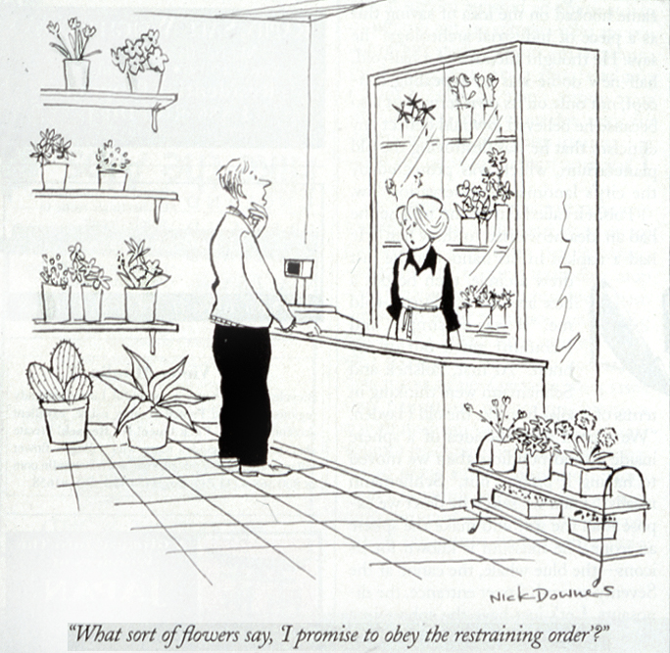

Slide 169
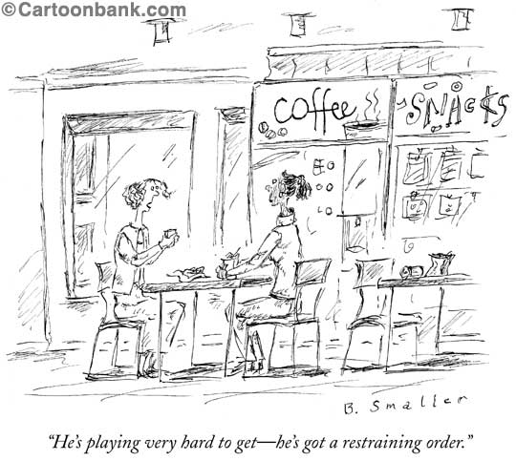

Slide 170
Stalking of Mental Health Practitioners
Frequency of mental health practitioners being stalked during their career:
  3% (Sandberg, et al., 2002)
  20% (McIvor, et al., 2008; Purcell, et al., 2005)
  14% - psychologists (Kivisto, et al., 2016)
    Psychologists who engaged in a forensic practice were twice as likely to be stalked than psychologists who did not
  23% - Storey, 2016
Frequency of mental health practitioners being stalked during their lifetime:
  10% (Galeazzi, et al., 2005; MacLean et al., 2013)

Slide 171
Stalking of Mental Health Practitioners
(Kivisto, et al., 2015)
Threats moderately associated with physical attacks (r-.29)
Among the 21% of psychologists who were threatened (n=33), only 12.1% (n=4) were attacked
Among all of those who were attacked, all were threatened

Slide 172
Stalking of Mental Health Practitioners
Duration
61.5 weeks (SD = 89.37), Kivisto, et al., 2016
  Most common
    Outpatient psychotherapy patient
    Outpatient forensic evaluatee
23 weeks (SD = 34.29), Storey, 2016

Slide 173
Stalking of Mental Health Practitioners
Characteristics (Kivisto, et al., 2016)
  Average age when stalking commenced: 25.36 (SD=9.04)
  More than half of patients were female (59.1%)
  Mental illness at time of stalking (77.3%)
  Presence of a personality disorder (60.7%)
    Specific diagnoses:
      Borderline Personality Disorder
      Paranoid Personality Disorder

Slide 174
Stalking of Mental Health Practitioners
Location
  Seeing persons at home not associated with greater risk for stalking victimization (Storey, 2016)
Relationship
  Most common relationship was professional at 50% (client, co-worker, acquaintance of client), Storey, 2016

Slide 175
Stalking of Mental Health Practitioners
Factors potentially placing MHP at risk:
  Treatment of forensic, substance abuse and sexuality issues was significantly associated with being stalked (Storey, 2016).
  Psychologists endorsing psychodynamic/psychoanalytic, family systems had higher rates of stalking victimization that those endorsing a cognitive-behavioral stance

Slide 176
Relevant Instruments

Slide 177
Comparison of the HCR-20V3, the WAVR-21V3, and the CAG Performance Across Workplace Homicide Scenarios: A Pilot Study (Scalora et. al., 2020)
results suggest; three instruments demonstrated a potential to guide risk assessment processes effectively

Slide 178
Workplace Assessment for Violence Risk - 21 v3
(White and Meloy, 2016)
Structured Professional Judgment
Assessment of targeted violence risk and/or threat in workplace
Adults
Male and female
Does not identify motive
www.wavr21.com

Slide 179
Workplace Assessment for Violence Risk - 21 v3
(White and Meloy, 2016)
21 Items
19 Risk Items
2 Protective Factors
Coded as absent, present, prominent

Slide 180
WAVR-21, v3
Risk Items
Motives for violence
Homicidal fantasies, violent preoccupations, identifications
Threatening Communications or Expressed Intent
Weapons skill and/or access
Pre-attack planning and preparation
Stalking or menacing behavior
Current job or academic problems
Extreme job or academic attachment
Loss, personal stressors and negative coping
Entitlement and other negative traits
Lack of conscience or responsibility
Anger problems

Slide 181
WAVR-21, v3
Risk Items
Suicidality and other depression
Irrationality suspicious or bizarre beliefs
Substance abuse and dependence
Increasing isolation
History of violence, criminality, and/or conflict
Domestic/intimate partner violence
Situational and organizational contributors to violence

Slide 182
WAVR-21, v3
Protective/Organizational
Stabilizers and buffers against violence
Organizational impact of real or perceived threat

Slide 183
Historical Clinical Risk – 20, v3
Douglas, Hart, Webster, Belfrage, 2013
The HCR-20v3 is intended to facilitate assessments of risk for interpersonal violence, defined as deliberate actual, attempted, or threatened inflictions of bodily harm on another person
http://hcr-20.com/

Slide 184
Intended Populations & Settings
Demographics
  Men and women 18 years of age and above
    Exception: Evaluator discretion may be used with individuals aged 16 or 17, if they have been living independently
      When used with adolescents, this tool should be paired with another
Settings/Application Use
  Forensic psychiatric, civil psychiatric, workplace, and correctional/law enforcement settings
  When there is a legal or clinical need → need for a decision to be made regarding placement, treatment, or management
    Not necessarily for in-the-moment decisions regarding imminent risk
Notes:
Speaker Notes:
When used with adolescents, these following tools should also be used in conjunction with the HCR-20v3:
Structured Assessment of Violence Risk in Youth - SAVRY; Borum, Bartel, & Forth, 2006
Youth Level of Service/Case Management Inventory - YLS/CMI; Hoge & Andrews, 2002)

Slide 185
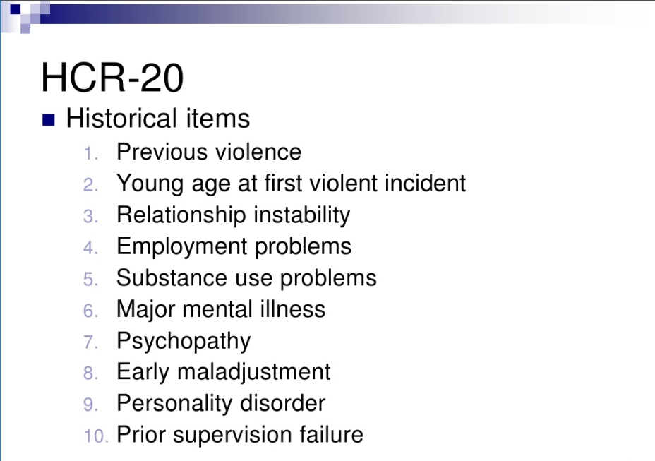
HCR-20v3 Historical

Slide 186
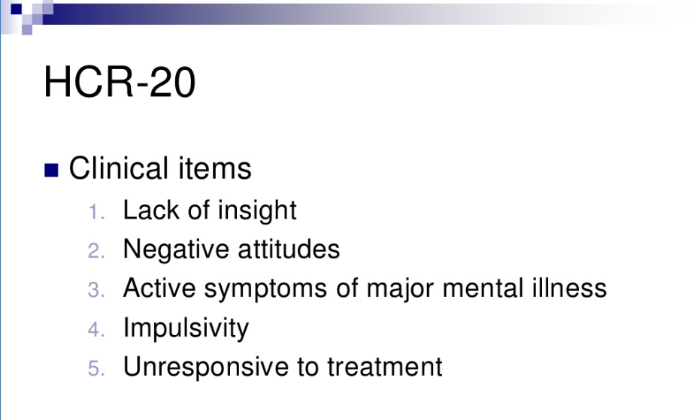
HCR-20v3 Clinical

Slide 187
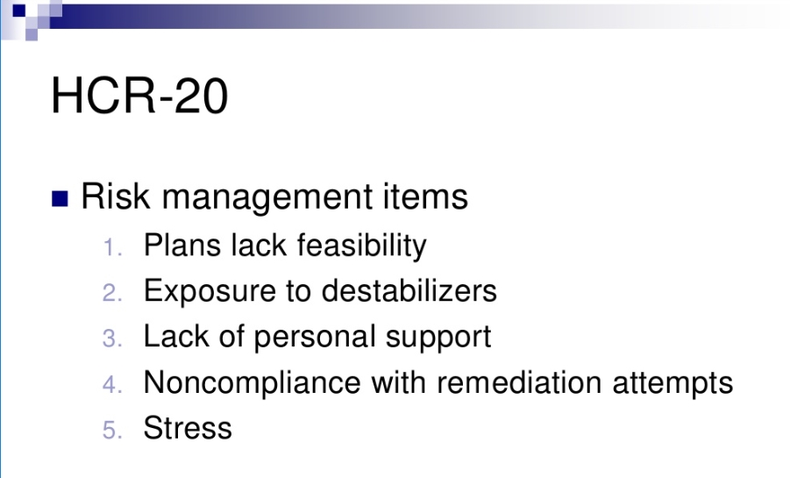
HCR-20v3 Risk

Slide 188
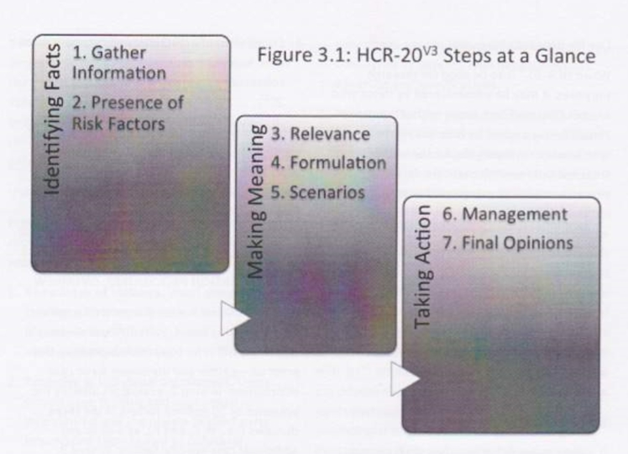
Procedure Overview

Slide 189
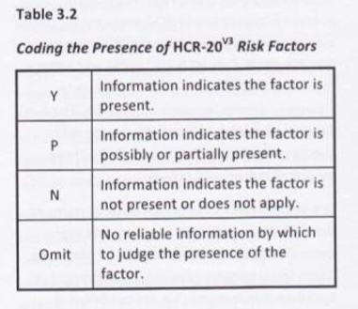
Coding
Code “Y” (Yes) → risk factor is definitely or conclusively present (indicated as “2”)
Code “P” (Possible/Partial) → risk factor is present, but the case information is weak, contradictory, or inconclusive (indicated as “1”)
Code “N” (No) → based on reliable case information, the risk factor is absent (indicated as “0”)
Code OMIT → there is no reliable information (or information is missing) by which to judge the presence of the risk factor

Slide 190
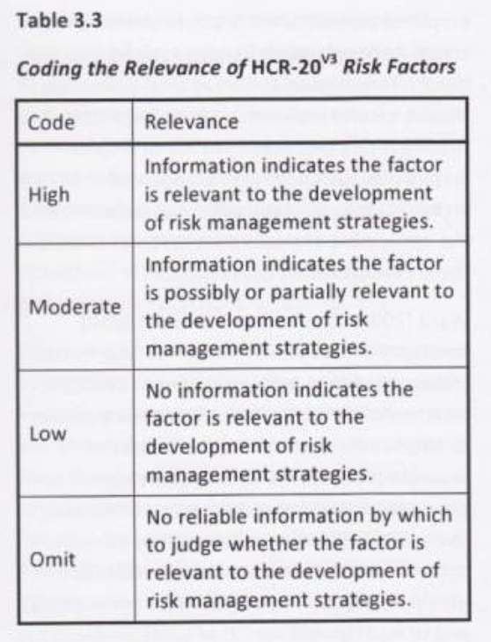
Relevance of Risk Factors
•The extent to which the risk factor is critical to formulation of what caused the evaluee to act violently and how to best prevent it again in the future
•What makes a risk factor relevant?
•Relevance of risk factors should always be determined after all of the
presence ratings are coded for
•Three functional roles to engage with violence
•Motivate, Disinhibit, Destabilize
•Coded on 3-level scale
•Low
•Moderate
•High
Notes:
Step 3:
Require that evaluators not only consider if risk factors are present, but how they are relevant to violence risk
Describe how the risk factors manifest
Relevant if
Material contribution to past violence
Likely to influence violence in the future
Likely to impair capacity to employ non-violent techniques
Crucial to manage factor in order to mitigate risk
Motivate
Violence is a rewarding option
Disinhibit
Evaluee is less likely to be influenced by restraints, regardless if
intrinsic/extrinsic
Destabilize
Disturb ability to monitor and control decision making
Judgements about relevance are hypotheses based on research, experience and case facts

Slide 191
Guidelines for Stalking Assessment and Management (SAM)
Kropp, Hart & Lyon, 2008
www.proactive-resolutions.com

Slide 192
Populations and Purpose
Structured Professional Judgement Guidelines
Assessment and management of risk for Stalking
Systemic, standardized, formal approach
Total of 3 domains – 30 items in total
Intended use for cases when there is a known or suspected history of stalking
18 or older, regardless of gender
Child and adolescents use is limited, at best
Best with single perpetrator and single victim

Slide 193
Coding Presence and Relevance
Items coded as either
  Yes, ?, N, Omit
Relevance coded as either
  Yes, ?, N, Omit
Time Frames
“Current” versus “Prior”
  Current = status of factors since start point of most recent pattern of stalking behavior
  Prior = past stalking of the same or different primary victim

Slide 194
Final Step – Conclusory Opinion
Document Summary Judgement
  Case Prioritization: Low, Moderate or High
    Level of intervention needed to prevent person from committing stalking
  Risk for Continued Stalking
    Low, Moderate or High

Slide 195
Final Step – Conclusory Opinion
Document Summary Judgement
  Risk for Serious Physical Harm
    Low, Moderate or High
  Reasonableness of Fear
    Extent that victim’s fear corresponds to the severity of the stalking
    In light of total circumstances, degree to which primary victim’s concerns/fears seem reasonable

Slide 196
Final Step – Conclusory Opinion
Document Summary Judgement
  Immediate Action Required
    Question of imminence
  Case Review
    Frequency of review in the future
    General recommendation is every 6-12 months

Slide 197
Nature of Stalking Domain
Communicates about victim
Communicates with victim
Approaches victim
Direct contact with victim
Intimidates victim
Threatens victim
Violent toward victim
Stalking is persistent
Stalking is escalating
Stalking involves supervision violations

Slide 198
Perpetrator Risk Factors
Angry
Obsessed
Irrational
Unrepentant
Antisocial lifestyle
Intimate relationship problems
Non-intimate relationship problems
Distressed
Substance abuse problems
Employment and financial problems

Slide 199
Victim Vulnerability Risk Factors
Inconsistent behavior toward perpetrator
Inconsistent attitude toward perpetrator
Inadequate access to resources
Unsafe living situation
Problems caring for dependents
Intimate relationship problems
Non-intimate relationship problems
Distressed
Substance use problems
Employment and financial problems

Slide 200
Thank you!
www.drforensic.com
kostas@drforensic.com

