Slide 1


General Overview of ICS
Focus on LTC
Presented by the Central and West Central MN Healthcare Preparedness Coalitions

Slide 2
WebEx etiquette
Please Mute your phones or computers for the presentation.
The “chat” function is available if you have a question.
There are discussion points at end of presentation
Discuss the questions in your group and use the chat feature to share your answers with everyone.
  Make sure to “Select to everyone” so all participants can see your answers

Slide 3
Facilitator
Don Sheldrew: Central Regional Health Care Preparedness Coordinator

Slide 4
Purpose
To provide guidance of the use of National Incident Management Systems (NIMS) Incident Command System (ICS) in Long Term Care (LTC) and clinical settings with the understanding that many facilities have minimal staff and proper placement of staff in ICS roles are crucial to effective management of emergencies, evacuation, and/or influx/surge of Senior occupants

Slide 5
Objectives
Review the basic principles of the Incident Command System
Describe the role and responsibilities of the Command and General Staff with focus on incident commander and public information officer
Apply these roles and responsibilities to the LTC and Clinic environment

Slide 6
What is HICS?
The Healthcare Incident Command System:
  A standardized, on-scene, all-hazard incident management concept that meets the needs of incidents of any size
  Allows its users to adopt an integrated organizational structure to meet demands of single or multiple incidents without being hindered by jurisdictional boundaries
Notes:
Allows personnel from a variety of agencies to meld into a common management structure
Provides logistical and administrative support to operational staff
Is cost effective by avoiding duplication of efforts

Slide 7
Features of ICS
Common Language & Terminology
Chain of Command
  Orderly line of authority, lower levels subordinate to higher
  Every individual is responsible to ONE supervisor during an incident- they should know who this person is and how to contact them
Manageable Span of Control
Is a management system and not an organizational chart
Notes:
Chain of Command feature helps to clarify reporting relationships to eliminate confusion caused by multiples, perhaps conflicting directives
Incident managers at all levels must be able to control the actions of all personnel under their supervision
Chain of command is a series of command, control, executive, or management positions in hierarchical order of authority
For example, a unit leader does not report directly to IC
Unity of command means that every individual has a designated supervisor to whom they report at the scene of the incident

Slide 8
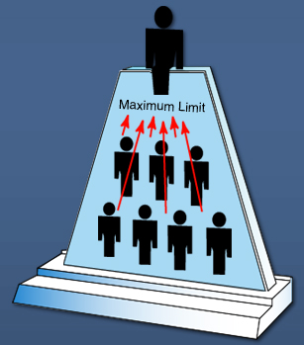
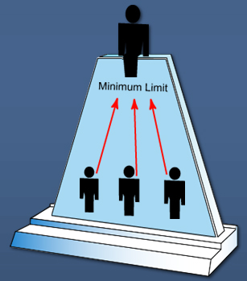
Span of control
One should not be responsible for more than 5 persons in an emergency
More than 5 direct subordinates should create new division of labor
Creates better Safety, Accountability, Efficiency
Notes:
In The Journal of Nursing Administration. Vol 34(9), Sept. 2004, pp 395-399 found that a smaller span of control produced a better employee engagement and showed the difficulties in managing a large span of control.
Span of control is built by the IC based off the needs of the incident
General staff is usually designated first (specifically operations section is created first)
As incident increases or changes command staff is designated

Slide 9
HIcs Team organization
Command Staff
General Staff

Slide 10
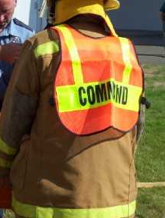
Incident Commander
Important to understand that the ICS does not have to match up to the organizational chart of a health care location
Example: charge nurse can be the IC while the VP of operations can be Logistics or operations chief and the VP of finance can be Finance chief
Notes:
, the higher ranking or more qualified person will either assume command, maintain command, or transfer command to a third party

Slide 11
Incident commander role
Fore most- Incident Commander (IC) is responsible for all roles in the command and general staff
Only position ALWAYS staffed
Provides overall leadership for incident response
Delegates authority to others
Takes general direction from agency administrator/official

Slide 12
Incident commander responsibilities
Ensuring incident safety
Providing information services to internal and external stakeholders
Establishing and maintaining liaison with other agencies participating in the incident
Assess need for staff
Establishes incident objectives
Directs staff to develop the Incident Action Plan – these plans are available on the Regional website www.cwchealthcarecoalitions.org
Notes:
Black underlined text is a hyperlink to a webpage that provides all Incident command forms needed. It is important for any organization to have some of these forms prefilled out for events that have a high risk of occurrence.
It is important to understand span of control and how it can help the IC better assess need for staff.

Slide 13
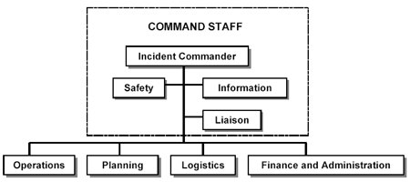
Command staff
Comprised of for most incidents
  Safety officer
  Liaison officer
  Public information officer
For unique organizations an additional officer can be added.
  Med/Tech Specialist
    An advisor to the IC for specific
Notes:
A lot of these positions is going to be one person doing it…..

Slide 14

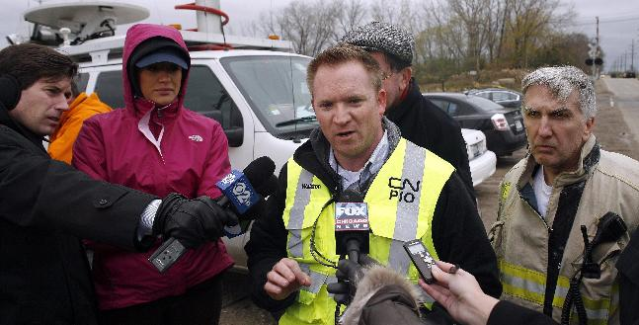
The Public Information Officer is responsible for interfacing with the public and media and/or with other agencies with incident-related information requirements

Slide 15
Public Information Officer Responsibilities
Gathers, verifies, coordinates, and disseminates accurate, accessible, and timely information on the incident’s cause, size, and current situation; resources committed; and other matters of general interest for both internal and external audiences
May also perform a key public information-monitoring role
The Incident Commander/Unified Command must approve the release of all incident-related information
In large-scale events the facility PIO should work with other agencies involved to ensure consistency in the provision of information to the public
Notes:
You want someone with the following skills:
Excellent formal written, verbal, and public speaking skills
Ability to explain complex issues to any audience
Knowledge emerging communication systems (social media)
Develop and maintain relationships (internal and external)
Familiar with policies, procedures, and daily operations
Can handle long and varying hours under stressful conditions

Slide 16
Liaison Officer “The Coordinator”
Conveys information about how the facility is responding to the situation to outside agencies
To be a link between the facility command center and other response organizations (healthcare facilities, emergency management, EMS, etc.)
Notes:
Individuals that may fullfill this role should:
Someone that knows the response world outside of the facility, especially the Healthcare Coalition
Has existing relationships with outside agencies and internal departments
Good interpersonal and communication skills
Training in risk communications and public relations
Trustworthy

Slide 17
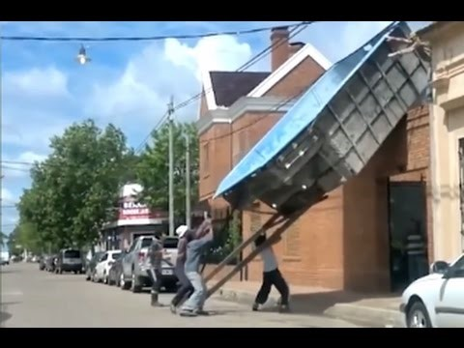
Safety

Slide 18
Safety Officer “The Protector”
  Ensure the health and safety of patients, facility personnel, and visitors
  Identify and mitigate hazardous conditions
  Comply with appropriate regulations
  Document injuries or accidents
  Exercise emergency authority to stop response for unsafe conditions
  Prepare the IAP Safety Analysis (HICS 215A)
  Review and approve the Staff Medical Plan (HICS 206)
Notes:
Individuals in this role should:
A “Safety” mindset
Safety knowledge: regulations, hazardous materials, infection control, engineering controls, injury prevention, accident investigation
Ability to keep a global view of the response
Knowledge of response plans

Slide 19
Medical/technical Specialist
Advisory position to provide the IC with specific Guidance
Typically this person is the individual/agency that you would call to ask specific questions:
  Infection Prevention
  Medical director
  Minnesota Department of health
  Infrastructure damage questions

Slide 20
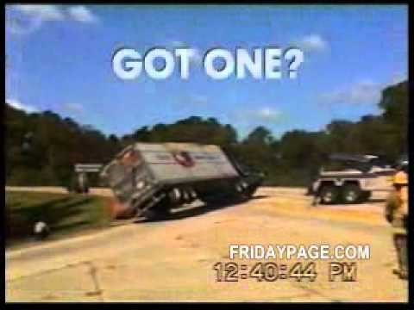
Example of the need for action plans

Slide 21
Operations – THE DOERS!!
Operations is in charge of carrying out the facility objectives
The chief will develop strategy and goals to complete the objectives
Operations section is broken down into teams (if you have the staff available)
        Patient Care Branch
        Infrastructure Branch
        Security Branch
        Hazard Mat Branch
        Business Continuity Branch
        Patient Family Assistance Branch
Notes:
Persons in this role have:
Leadership skills: capable of organizing and directing others in working toward common goals
Trustworthy
Knowledge of the day-to-day operations and key people in the organization
Safety oriented and aware of special precautions required for unusual emergency situations
Ability to look ahead and anticipate needs.
Multi-tasking and know how to prioritize tasks
Basic knowledge of ICS

Slide 22
Planning section
Responsibilities
  Collecting, evaluating, and displaying incident intelligence and information
  Preparing and documenting incident action plans
  Tracking resources assigned to the incident
  Maintaining incident documentation
  Developing plans for demobilization
Notes:
Persons in this role have:
Emergency response training and experience, specifically with ICS forms
Be able to work under pressure
Analytical skills and be results-oriented
Be able to manage personnel during a dynamic, expanding incident
Good facilitator for meetings
Good interpersonal and communication skills
Trustworthy

Slide 23
Planning resources
Resources are defined as units
Units found in planning are:
  Resources unit
  Situation unit
  Demobilization unit
  Documentation unit
Notes:
Resources Unit: Responsible for recording the status of resources committed to the incident. This Unit also evaluates resources committed currently to the incident, the effects additional responding resources will have on the incident, and anticipated resource needs.
Situation Unit: Responsible for the collection, organization, and analysis of incident status information, and for analysis of the situation as it progresses.
Demobilization Unit: Responsible for ensuring orderly, safe, and efficient demobilization of incident resources.
Documentation Unit: Responsible for collecting, recording, and safeguarding all documents relevant to the incident.

Slide 24

Recovery plan- How many have one like this?

Slide 25
Logistics Section
Responsibilities
  Ordering, obtaining, maintaining, and accounting for essential personnel, equipment, and supplies
  Providing communication planning and resources
  Setting up food services for responders
  Setting up and maintaining incident facilities
  Providing support transportation
  Providing medical services to incident personnel
Notes:
Persons in this role have:
Good manager and leadership skills
Understand day-to-day resources: availability, ordering, tracking, receiving, and distribution
Ability to anticipate resource needs during a response
Is well-known in the organization and knows others to ask for help

Slide 26
Logistics resources
Depending upon staffing, one person may be responsible for all:
Resources defined as Units
Supply unit
Ground support unit
Facilities unit
Food unit
Communication unit
Medical unit
Notes:
Supply Unit: Orders, receives, stores, and processes all incident-related resources, personnel, and supplies.
Ground Support Unit: Provides all ground transportation during an incident. In conjunction with providing transportation, the Unit is also responsible for maintaining and supplying vehicles, keeping usage records, and developing incident Traffic Plans.
Facilities Unit: Sets up, maintains, and demobilizes all facilities used in support of incident operations. The Unit also provides facility maintenance and security services required to support incident operations.
Food Unit: Determines food and water requirements, plans menus, orders food, provides cooking facilities, cooks, serves, maintains food service areas, and manages food security and safety concerns.
Communications Unit: Major responsibilities include effective communications planning as well as acquiring, setting up, maintaining, and accounting for communications equipment.
Medical Unit: Responsible for the effective and efficient provision of medical services to incident personnel.

Slide 27
Finance/administration section
IC will always determine if any section needs to stand up
Responsibilities
  Contract negotiation and monitoring
  Timekeeping
  Cost analysis
  Compensation for injury or damage to property
  Documentation for reimbursement (e.g., under mutual aid agreements and assistance agreements)
  Business continuity
Notes:
Resources defined as Units
Compensation/Claims Unit
Cost Unit
Procurement Unit
Time Unit
Compensation/Claims Unit: Responsible for financial concerns resulting from property damage, injuries, or fatalities at the incident.
Cost Unit: Responsible for tracking costs, analyzing cost data, making estimates, and recommending cost savings measures.
Procurement Unit: Responsible for financial matters concerning vendor contracts.
Time Unit: Responsible for recording time for incident personnel and hired equipment.
Persons in this role:
A “numbers” person
Understand day-to-day financial status of the organization (budget, cash reserves, insurance coverage, procurement process)
Understand how to manage response finances (emergency spending limits/credit, MOUs, insurance coverage, potential programs for reimbursement)
Ability to anticipate expenditures that may be needed during a response

Slide 28
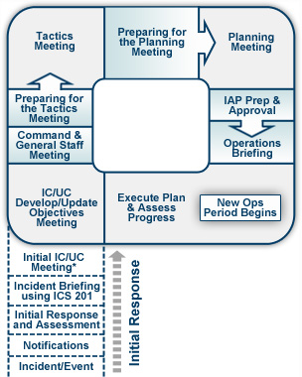

Slide 29
Review
Incident command system is flexible starting with the incident commander
Dependent on the phase, incident(s), resources needed the IC management structure can increase and decrease as needed
One person can do more than one position dependent on Span of Control

Slide 30
Discussion
With the provided power point information a disaster has occurred and your facility will be either evacuating or inflexing of patients
Take 5-10 minutes with yourself or your group to discuss who could be in the ICS structure and how many roles could each person potentially manage effectively

Slide 31
Questions?

