Slide 1
Basic System and Subscriber Programming Considerations
Developed and presented by
On Target Training and Consulting LLC
Contact us at 320-584-5416
Ontarget.tc@msn.com

Slide 2
System and Subscriber Programming Considerations
Table of Contents:
Definitions
Fleetmap considerations
System programming considerations
Subscriber programming considerations
Console considerations

Slide 3
System and Subscriber Programming Considerations
Before we begin, lets look at the definitions:
Remember that most definitions and acronyms can be found on the ARMER website. ARMER
Listed are those I recommend you should become most familiar with:
Alias | Emergency Alarm | Master Site | Roaming | Subscriber
ARMER | Emergency Call | Multi-group | Simulcast | Template
CALL Alert | Encryption ADP/DES OFB/AES | Multi-site | Site | Talkgroup
CPS | Fail-soft | Private Call | Site Trunking | Wide Ttrunking
Code Plug | Fleet map | PTT | System ID | Zone
Dynamic Regroup | ISR/ASR | Repeater | System manager

Slide 4
System and Subscriber Programming Considerations
Definitions
Alias
ARMER
Call Alert
CPS
Code Plug
Dynamic Regroup
Emergency Alarm
Emergency Call

Slide 5
System and Subscriber Programming Considerations
Definitions cont.
Encryption
ADP/ DES OFB/ AES
Fail-soft
Fleetmap
ISR/ASR (Multicast)
Master site
Multi group
Multi-site

Slide 6
System and Subscriber Programming Considerations
Definitions cont.
Private Call
PTT
Repeater
Roaming
Simulcast
Site
Site Trunking

Slide 7
System and Subscriber Programming Considerations
Definitions cont.
System ID
System Manager
Subscriber
Template
Talkgroup
Wide Trunking
Zone

Slide 8
Fleet Mapping Basics
Understand the basic codeplug building process
Understand preparation steps required to develop a codeplug
Understand available tools
Know where information resides to assist with building of the codeplug

Slide 9
Fleet Mapping Basics
Why is a Fleetmap Important?
Allows customized choices
Provides unique insight on trunking system operations
Encourages interoperability planning among local, regional, and state users
Gain intricate knowledge of how P25 products work

Slide 10
Fleet Mapping Basics
Information requirements
System Key (s) containing Trunked System ID numbers Trunked Control Channel Frequency List
ARMER Trunked System ID = 740F
ARMER WACN ID = BEE07
Conventional Frequencies with Alias’ list
Talkgroup/Announcement Group list with names and ID numbers
List of Radio ID numbers cross-referenced to radio names (alias’)
Talkgroup fail-soft frequency plan

Slide 11
Fleetmap Development Technical Skills
Understand P25 trunked system operational modes
Wide Area – Simulcast and ASR roaming
Site trunking
Fail-soft
Knowledge of subscriber features
Understand subtle differences between portable and mobile subscribers

Slide 12
Fleetmap Developer Technical Skills
Knowledge of Motorola console products
MCC 7500
Gold Elite
User Configuration Management (UCM)
development rules
Microsoft Excel or Access knowledge
Knowledge of Customer Programming Software (CPS)

Slide 13
Fleetmap Process Phases
Preparatory Documentation
Fleet Education
Ongoing User Consultation
Subscriber & Console Template Build
CPS Codeplug Test
Mass Programming
We should review the ARMER Standards, specifically SECTION 2

Slide 14
Fleetmap Process Phases
Preparatory Documentation
Customer Education
Ongoing Consultation
Subscriber & Console Template Build
CPS Codeplug Test
Mass Programming
Subscriber Template forms
TG Records form
Prepare milestones
Download seed code plugs from subscribers
Secure System Key(s)
Notes:
Show TDR form

Slide 15
System Key
What is it?
Computer file containing the customer’s trunked system ID number
OR
Advanced System Key (ASK)
Notes:
Show Sys Key file!

Slide 16
Fleetmap Process Phases
Preparatory Documentation
Fleet Education
Ongoing Consultation
Subscriber & Console Template Build
CPS Codeplug Test
Mass Programming
Trunking system modes
TG operations
Subscriber features and operations
Console features
Fleetmap data forms introduction

Slide 17
Fleetmap Process Phases
Preparatory Documentation
Customer Education
Ongoing Consultation
Subscriber & Console Template Build
CPS Codeplug Test
Mass Programming
Continue technical assistance to fleet
Compile templates
UCM record development for System Manager
Enter TG & Subscriber information into UCM

Slide 18
Fleetmap Process Phases
Preparatory Documentation
Customer Education
Ongoing Consultation
Subscriber & Console Template Build
CPS Codeplug Test
Mass Programming
Critique/correct Excel templates
Create trunk system information in seed code plugs
Create Master agency code plugs
Codeplug build review

Slide 19
Fleetmap Process Phases
Preparatory Documentation
Customer Education
Ongoing Consultation
Subscriber & Console Template Build
CPS Codeplug Test
Mass Programming
Codeplug tests on live system
Final codeplug corrections made
Create all required code plugs from Masters

Slide 20
Fleetmap Process Phases
Preparatory Documentation
Customer Education
Ongoing Consultation
Subscriber & Console Template Build
CPS Codeplug Test
Mass Programming
Transfer subscriber data forms to contractor
Transfer code plugs to contractor
Begin codeplug deployment
Inventory Control

Slide 21
Some Elements of a Fleetmap
Multigroup and talkgroup Syntax
Multigroup and talkgroup ID’s (Hex Code)
Simplex resources (SOA’s)
Permissions
Console considerations
Encryption Security Management

Slide 22
System Level Features That Drive Fleet maps
Talkgroup / Multigroup Profiles
Secure assignment
Priority levels (2-10)
Site Access authorizations
Emergency Validation
Priority Monitor
All or Fast Start mode
Regroupable

Slide 23
Fleet Mapping Basics Information Sources
System Keys
MNDOT OEC
Conventional Frequencies with Aliases list
System Owners / MNDOT OEC / ARMER
Talkgroup/Announcement list with names and ID numbers
MNDOT OEC
Talkgroup Fail-soft Frequency Plan
System Owners / MNDOT OEC
Radio Specific Programming Layout
Custom programming specifics per user group

Slide 24
Subscriber Level Features That Drive Fleet maps
Emergency Alert/Call
Dynamic regrouping
Telephone interconnect
Secure operations (encryption)
Trunked scan operations
Multigroup (MG) assignments
Radio Wide configuration

Slide 25
MCC 7500 Console Level Features That Drive Fleet maps
Emergency Call processing
TG/MG Assignment Plan
MultiSelect Plan
TG Patch Plan
Console takeover priority (explain)
Operator level programming options
Alert tones
Paging
Channel marker

Slide 26
Additional Fleet Map Considerations Agency Group Definition
One code per Agency
Assigned by MNDOT (2-character code)
Ideal for recordkeeping and reports tracking
Useful to reduce time doing record searches
No limit on quantity

Slide 27
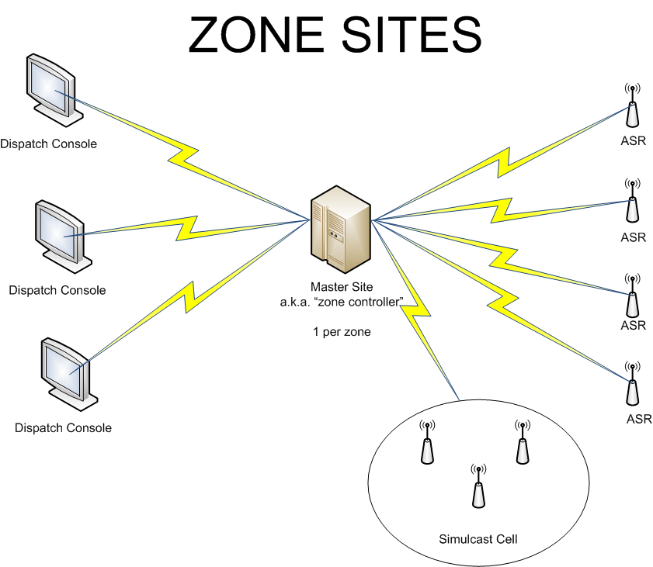
Trunking System Simplified Block Diagram

Slide 28
Trunking System Modes: Wide
Wide area
Roaming capable (if allowed)
Statewide access
Multi-zone
Multi-site
Full system functionality

Slide 29
Trunking System Modes Site Trunking
Site Trunking
(Failure mode #1)
Zone isolated
Multi-zone not capable
multi-site not accessible
Subscribers are still trunking
No “direct” contact with dispatch consoles

Slide 30
Trunking System Modes: Fail-soft
Fail-soft
(Failure mode #2)
Zone isolated
Multi-zone not capable
Multi-site not accessible
Revert to “shared repeater” system
Fail-soft operation at console level
Subscriber fail-soft programming options
Roam, lock on repeater or roam (leave site)

Slide 31
Multigroup Definition
Members of disparate work groups are temporarily rerouted to a Supergroup via the trunking infrastructure allowing receiving users to hear priority voice messages from one initiating caller or dispatcher
Radios and consoles capable of monitoring/ initiating multiple MGs
Rule 1 – Each MG can support up to 255 TGs
Rule 2 – A MG and associated TGs must be mapped within the same zone

Slide 32
Multigroup Planning
Planning Rules
15 Talkgroups max. supported per MG
A Talkgroup can only be associated with one MG
Secure vs. Clear (if applicable)
Wait vs. Interrupt mode
Console assignments
Define which TGs assigned to each MG
Notes:
Show Multigroup documentation sheet!

Slide 33
Talkgroup Considerations
Utilization
Naming convention
Interoperability
Layouts in subscribers
Personality/characteristics

Slide 34
Initial Talkgroup Considerations
Utilization
What do we need it for?
Consider true interoperability
Consider multi-discipline utilization
Shared “pools”

Slide 35
Initial Talkgroup Considerations
Naming Convention
What is it’s purpose
LAW
FIRE
Public Works
Emergency Management
Multi-discipline interop
Consider keeping the name simple
Consider character limitations

Slide 36
Initial Talkgroup Considerations
Interoperability
Who, what where when why how
CM Region examples
Fire example of primary service area
District 3 Sheriff’s “agreement” on resources in their county
Grant County anticipated Zone and talkgroup layouts

Slide 37
Initial Talkgroup Considerations
Layouts in subscribers
What zone/personality assignment, why?
Is there a way to affiliate talk groups by zone?
F=Fire, IC= Incident Command (all-branch), etc
CM is CM
County level
“Dodge 2” or “DD 2”
Can or should we consider each others zones? “Winona” “Houston” etc
For All disciplines?
Grant County anticipated Zone and talkgroup layouts

Slide 38
Additional Talkgroup Planning
100-200 assigned per agency (MNDOT)
Secure, clear, or both (if applicable)
Emergency Handling
Call Alert/Private Call/Telephone Interconnect
Encourage dialogue on interoperability
Between internal agencies
Between internal/external agencies
TG affiliation roaming between sites
Rule – A TG can be assigned to only one MG

Slide 39
TG/MG Records Development
Some things you Probably want to track by talkgroup:
ID number
Talkgroup alias
Allowed permission of use
Talkgroup profile
Capabilities and characteristics
Fast start or all start
In the Console?
Logged?
Site Access
Regroupable
Encryption

Slide 40
Subscriber Consideration’s
Trunked Personality
Channel assignments (talkgroup layouts)
Alias list
Scan Functions
Selections and lists
Fixed or selectable
Site preference
Menu and switch assignments
Multigroup
Emergency Button
Alarm, CALL, hot mic, tactical or revert

Slide 41
Subscriber Consideration’s
Site preference by personality
Can be by talkgroup
Always
Preferred
Least
None
The Site preference selections above effect performance of your radio’s, including in “Site trunking and Fail-soft”. A description of each setting is:

Slide 42
Subscriber Features Trunked Personality Site Preferences
Always
Will stay on this site in site trunking
Use this site as long as it is above the acceptable threshold
Radio will use this site unless the site drops to poor.
Preferred
Use this site as long as it is above the acceptable threshold
Radio will use this site unless the site drops to poor.
Radio will leave this site if the site drops to site trunking

Slide 43
Subscriber Features Trunked Personality Site Preferences
Least
Use this site as long as it is above the acceptable threshold
Don’t use this site unless there are no other options
Radio will only use this site if all other available sites are in the poor region or failed.
No preference
Recommended value for optimal system performance in all areas of system
Radio will operate on site if it is acceptable and no other sites are always preferred or preferred.
Treat all sites the same
Default value

Slide 44
Subscriber Consideration’s
Site trunking
Fail-soft
Encryption
Secure (strapped), Clear, Both
Surveillance Mode
Tones
Call List
Call Alert
Private Call
Announcement
Dynamic regroup

Slide 45
Alias Consistency Planning
Be aware of device character limitations differences
Motorola
XTS5000/2500 portable – 12 characters
XTS1500 Model 1.5 portable – 8 characters
MCC 7500 Console – 14 characters
You MUST understand importance

Slide 46
Subscriber Features Trunked Personality
There are 4 RSSI thresholds.
Excellent
Default range is –89 to -93 dBm
Very Good
Default range is –93 to –97 dBm
Good
Default range is –97 to –101 dBm
Acceptable
Default range is –101 to –105 dBm
Poor
Default range is -105 dBm or below
Radios need a 2 step RSSI level difference to consider switching sites

Slide 47
Subscriber Features Scan Functions
Trunked and Conventional Scan Decisions
Maximum number of members varies by subscriber
Priority Monitor, TG, and Conventional Scan modes
Define Priority mode - Fixed, Selected Channel, or Operator Select

Slide 48
Subscriber Features Scan Functions
Trunked and Conventional Scan Decisions
Define Non-Priority members
Voice Transmit Talk mode – Selected Channel or Talkback
Only one scan list assignable per trunked personality

Slide 49
Subscriber Features
Radio Wide Options
Alert tones
Home mode
Emergency Keep Alive
Time and Date format
Time Out Timer value
Out of Range indicators
Noise suppression

Slide 50
Subscriber Features Buttons and Switches
Controls (Buttons and Switches Decisions)
Mechanical rotary switches
Mechanical rocker A-B-C switch
Three side buttons

Slide 51
Subscriber Features Display & Menu
Display Menu (Soft Keys)
Three keys per radio
Trunking and conventional can have different programming choices

Slide 52
MCC 7500 Console Features
Resource Logging
Which TGs will be recorded?
Which conventional channels will be recorded?

Slide 53
MCC 7500 Console Features
MultiSelect and Patch
Three MSEL folders (default)
Three Patch folders (default)
Console can have pre-programmed MSEL choices
Console can have pre-programmed Patch choices

Slide 54
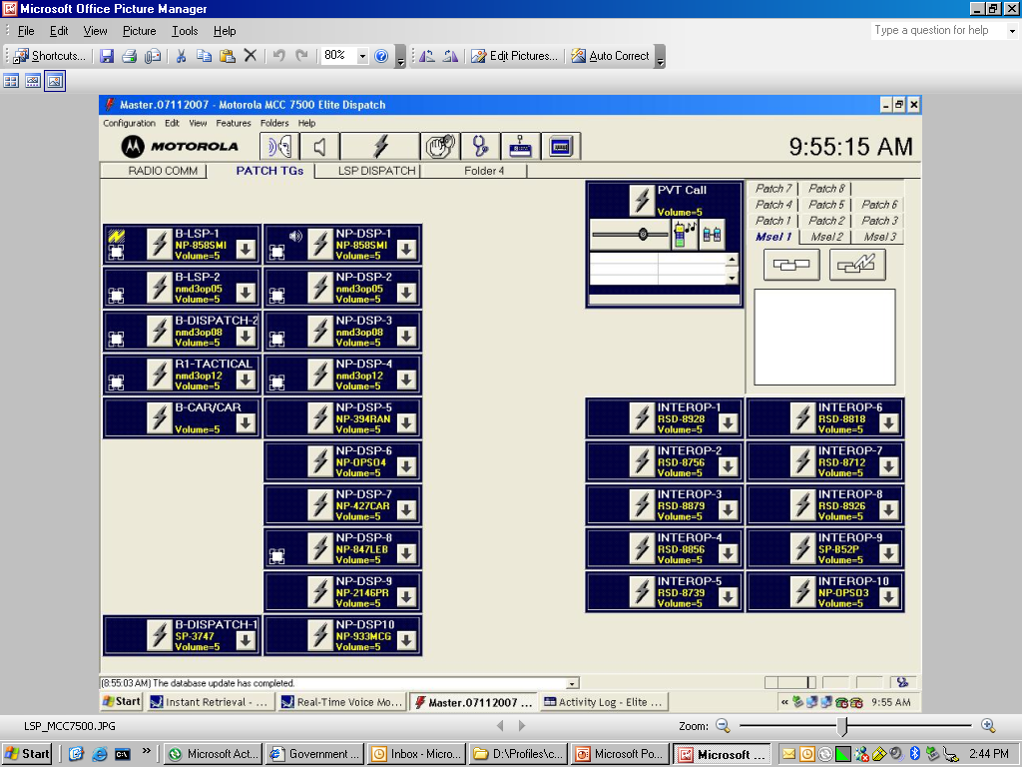
MCC 7500 Console Features

Slide 55
Thank you Questions?
Developed and presented by
On Target Training & Consulting LLC
Contact us at 320-584-5416
Ontarget.tc@msn.com

