Slide 1
Operational Planning cycle
Events most related to assembling an Incident Action Plan (IAP)

Slide 2
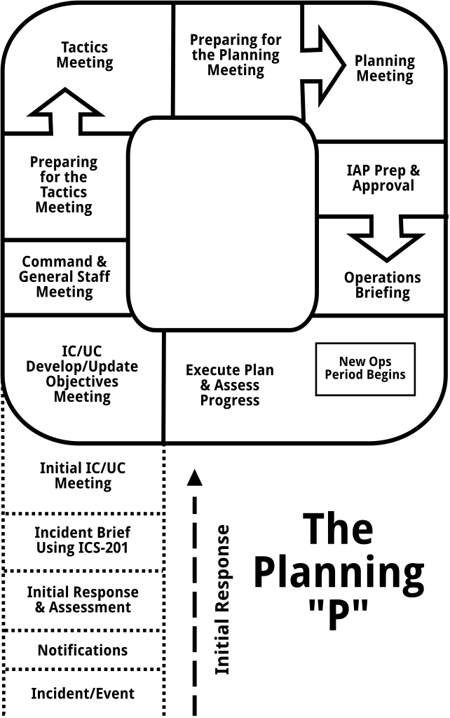
Introduction
The ICS Operational Planning Cycle
Systematic mechanism
Develop & Disseminate
Safe & Effective IAP for each operational period
All incidents start as a local response
Usually occur without warning
Events may have months of lead time
Allow for training, practice, drills, etc.
Notes:
Incident is an unplanned event, without warning
Event is planned and prepared for

Slide 3
notifications
You may be notified & you may notify in various ways
City/County Dispatcher
Government Agency
Emergency Management (EM)
Local Public Health (LPH)
Responsible Party
Gas/Electric company
Rail Road
Witness/By-Stander
News Agency
Victim/Patient/Family
Notes:
You may be notified of an event in your community by various sources, however it is often the first patients that you receive that are able to give you the most detail as to what occurred.
In some instances, you will be notifying others as to an incident that has occurred; in your facility or via information that you have gotten from patients that you are seeing in your facility.

Slide 4
Initial response & assessment
Activate Incident Command (if necessary) and notify members of the team.
Key Initial Players
IC – Incident Commander
OSC – Operations Sections Chief
LOFR – Liaison Officer
Notes:
During this time, you will need to determine what is happening, set-up some type of command, determine your initial objectives and an action plan, as well as setting up some initial communication pathways.

Slide 5
Activities Include
Situational Awareness
Evaluate potential incident complexity
Evaluate potential and current response actions
Request additional resources; as needed
Determine initial objectives & begin to act
Assign Incident Command Roles
Organize & direct response assets and members as they arrive and track resources
Identify appropriate communication methods and Operations & Command talk-groups; if using radio communications
COMPLETE the Incident Briefing Form (HICS IAP Quick Start Guide)
Notes:
During this phase, you will begin to evaluate your response actions, the potential incident complexity, do I need additional resources, share this information with the ICP or EOC, request additional Incident Management assistance if needed and complete the HICS 201 (Incident Briefing Form)

Slide 6
Hics quick start guide instructions

Slide 7
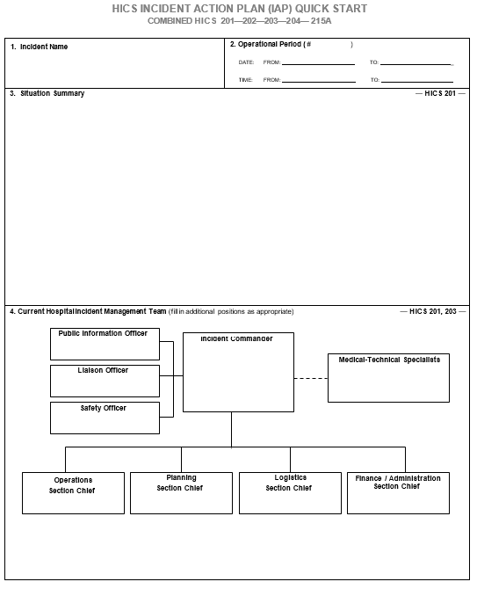
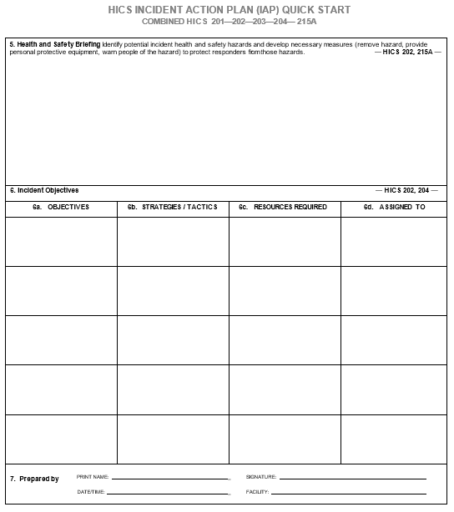

Slide 8
Incident brief
When it occurs:
Incident Command Activation
During a transfer of Command
What is it?:
A meeting where basic information is shared regarding the current incident situation & the resources allotted to the incident
Facilitator:
Current IC/UC or PSC (Planning Section Chief)
Attendee’s:
Incident Commander
Prospective IC/UC
Command & General Staff as available
Documentation:
A HICS IAP QSG
Most importantly the HICS IAP QSG functions as the IAP for the initial response, remains in force, & continues to be updated until the response ends, or the Planning Section generates the first comprehensive IAP
Notes:
This briefing occurs as needed during the transfer of command from the initial IC to a new IC or UC. This briefing is facilitated by the current IC/UC or the Planning Section Chief. The purpose of this brief is to share basic information regarding the current situation and resources that are allotted to the incident.

Slide 9
Briefing Agenda
Current situation
Who, what, where, when , why
Facilities established
Initial objectives & priorities
Current & planned actions
Current on-scene organization
Org Chart
Methods of communication; radio talkgroups if utilizing
Resource assignments
Resources ordered and/or En-route
Potential incident complexity
Notifications completed

Slide 10
After the briefing………
General Tasks
Incident Commander
Assesses operational requirements
Determines current/future organizational & response requirements & objectives
If activated, orders staff
Operations
Review available contingency plan(s)
Develops strategies & tactics
Assembles additional resources
Manages response using HICS IAP QSG
Starts planning for the Initial Command Meeting
If activated, orders staff

Slide 11
General Tasks – continued
Planning
Starts pulling together documentation for the IAP (QSG)
Starts planning for the Initial Command Meeting
If activated, orders staff
Logistics
Starts to identify needs
Gather HICS paperwork to track resources
Starts planning for the Initial Command Meeting
If activated, orders staff
Finance & Admin
Assess potential financial needs
Gather HICS forms for documentation
Starts planning for the Initial Command Meeting
If activated, orders staff

Slide 12
Initial unified command meeting
When it occurs:
After the briefing
After the IC staff and General Staff are able to assess the situation/identify needs
What is it?:
A brief meeting where IC members discuss important issues and make decisions based upon recommendations by each IC position and General Staff section.
This meeting provides the basis for the overall response efforts.
Facilitator:
Current IC/UC or PSC (Planning Section Chief)
Attendee’s:
Incident Commander
Command & General Staff as available
Documentation:
A HICS IAP QSG
Most importantly the HICS IAP QSG functions as the IAP for the initial response, remains in force, & continues to be updated until the response ends, or the Planning Section generates the first comprehensive IAP
Notes:
This is the time to get all the “leaders” together to chat briefly…this is a time to clarify, especially if there are multiple agencies involved.

Slide 13
Command Meeting Agenda:
Bring meeting to order and review ground rules and agenda
Identify & include the agencies & organizations that need to be represented in the IC/UC to accomplish the objectives
Identify assisting & coordinating agencies & organizations that are needed to accomplish the objectives
Clarify IC/UC roles & responsibilities
Review policies of representing agencies/organizations
Negotiate & agree on key decisions which may include;
IC/UC jurisdictional boundaries & focus; Area of Response (AOR)
Name of incident
Overall response organization, including integration of assisting & cooperating agencies
Location of ICP (if not already identified) and other critical facilities; as appropriate
Operational period length/start time and work shift hours
Command & General Staff composition; deputies as needed
Summarize & document key decisions
Notes:
This is the time to get all the “leaders” together to chat briefly…this is a time to clarify, especially if there are multiple agencies involved.

Slide 14
After the Initial unified command meeting……..
General Tasks
Incident Commander
Negotiates IC/UC participation
Clarifies IC/UC roles & responsibilities
Provides guidance to the IC and General Staff leaders
Negotiates key decisions including;
AOR of incident
Name of the incident
Overall response organization
Location of the ICP, facilities, & support
Op period length, start time, & work shift hours
OSC, DOSC, other key Command & General Staff, and technical support as needed
Notes:
.

Slide 15
General Tasks - continued
Operations
Briefs members on current operations
Assesses situation to determine best steps to respond
Assigns tasks to facilitate the objectives
Planning
Facilitates & documents meeting
Updates the IAP to include decisions discussed in the Command Meeting

Slide 16
IC/UC Objectives Meeting
When: Prior to Command & General Staff Meeting
Facilitator: IC/UC Member or PSC (if available)
Attendees: IC/UC Members, selected Command & General Staff, and the DOCL
IC/UC will set the response priorities, identify limitations & constraints, develop incident objectives, and establish guidelines for the IMT to follow.
During reoccurring meeting, products will be reviewed and updated
These products will then be shared at the Command & General Staff Meeting

Slide 17
IC/UC Objectives Meeting Agenda:
PSC brings meeting to order, conducts roll call, and reviews ground rules & agenda
Review and/or update key decisions
Develop or review and update response Functions, Priorities, Limitations, & Constraints
Develop or review incident objectives
Develop or review Critical Information Requirements (CIR), information flow, and time critical expectations
Develop, or review and update, key procedures which may include;
Managing sensitive information
Resource request & ordering process
Cost sharing & cost accounting
Operational security issues
Develop, or review and update, tasks for Command & General Staff to accomplish (ICS 233-CG)
Agree on division of IC/UC workload
Prepare for the Command & General Staff Meeting

Slide 18
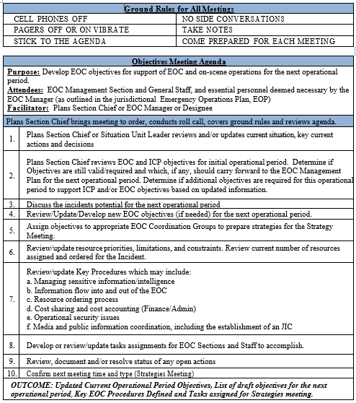
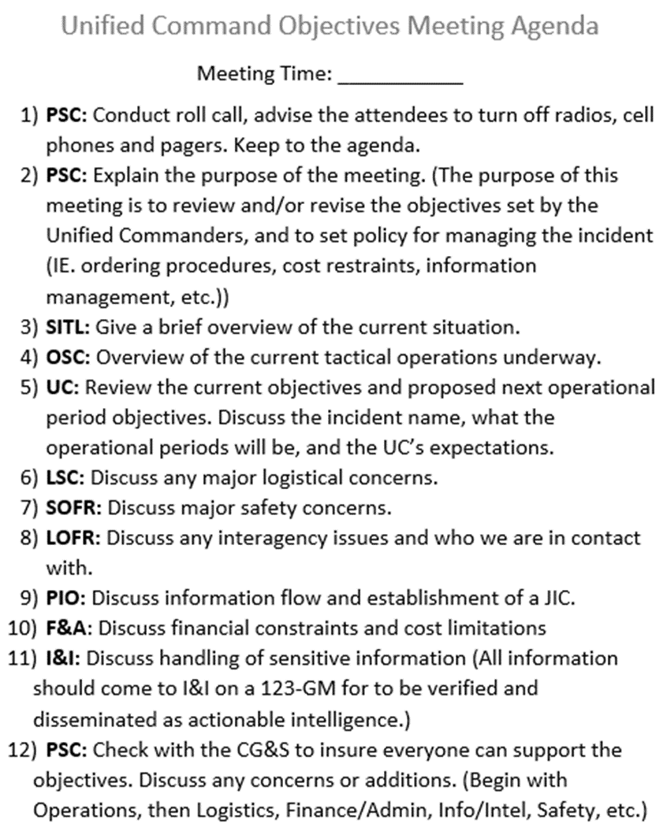
Sample Objectives meeting agenda

Slide 19
General Tasks:
Incident Commander
Develops incident priorities
Identifies limitations & constraints
Develops incident objectives
Defines Critical Information Requirements & their time criticality
Identifies key procedures
Develops tasks for Command & General Staff
Agrees on division of IC/UC workload
Operations
May be present if requires
Planning
Facilitates and documents meeting
Proposes draft objectives to Command

Slide 20
ICS 233-CG instructions

Slide 21
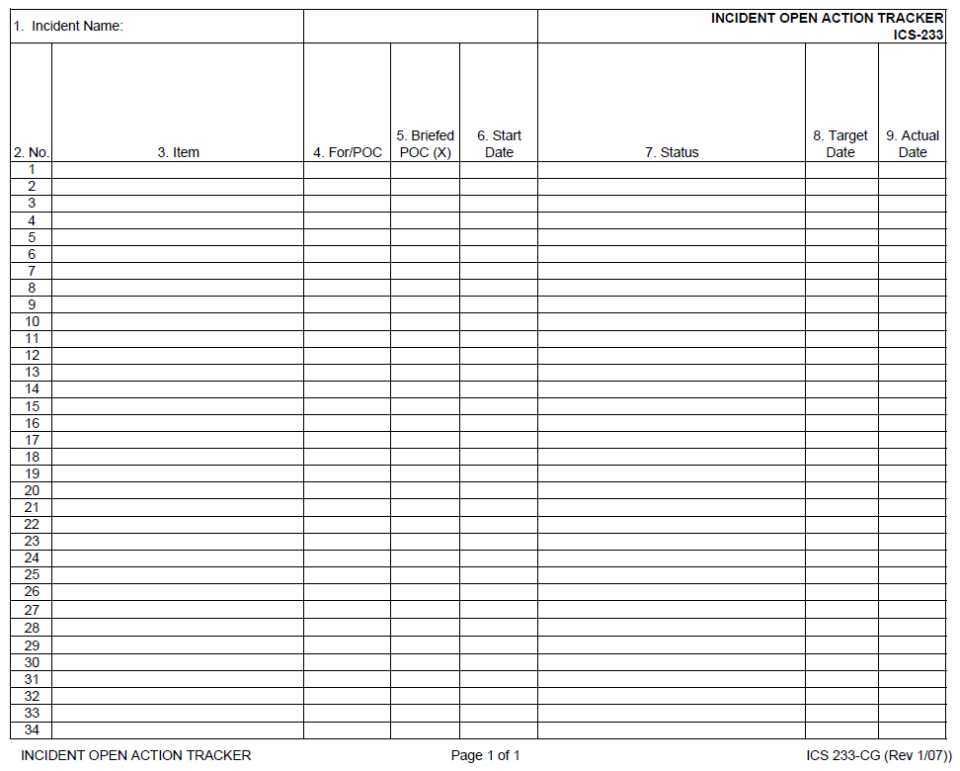

Slide 22
Command & General staff meeting
When: Prior to Tactics Meeting
Facilitator: PSC
Attendees: IC/UC members, Command & General Staff, Situation Unit Leader (SITL), DOCL, Communications Unit Leader (COML), Finance & Administration Section Chief (FSC), and the Logistics Section Chief (LSC) (as needed)
AKA. - STRATEGY Meeting
The IC/UC will present their decisions and management direction to the Command & General Staff. They should clarify & help to ensure understanding among core members of the IMT the decisions, objectives, priorities, procedures, & functional assignments that the IC/UC has agreed on (ICS 233-CG)
Notes:
This meeting sets the focus of the section chiefs as well as the path that the IC.UC is following.

Slide 23
Command & General Staff Meeting Agenda:
PSC brings meeting to order, conducts roll call, covers ground rules, & reviews the agenda
SITL conducts a situation status briefing
Safety Officer (SOFR) provides safety status briefing highlighting and near misses or injuries requiring medical attention beyond basic first aid and ICP safety issues
IC/UC:
Provides general comments
Reviews priorities, limitations, & constraints. Review key decisions & procedures. (if new or changed)
Discusses incident objectives
Reviews Critical Information Requirements (CIRs) and their time criticality
Assigns or reviews functional tasks/open actions (ICS 233-CG)
PSC facilitates open discussion to clarify priorities, objectives, assignments, issues, concerns, and open actions/tasks
IC/UC provides closing comments
PSC covers next meeting and planning process assignments
Notes:
This meeting sets the focus of the section chiefs as well as the path that the IC.UC is following.

Slide 24
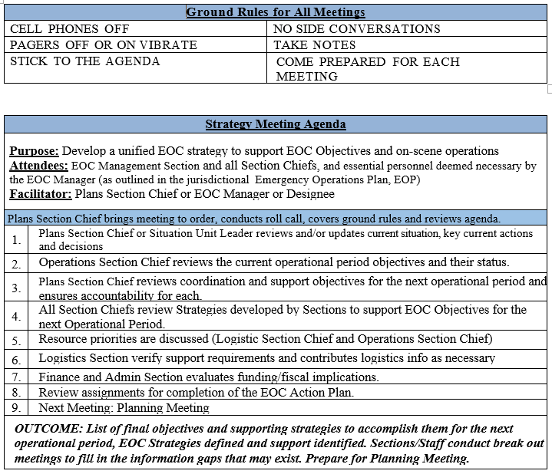
Sample command & general staff (Strategy) meeting agenda

Slide 25
General Tasks
IC/UC
Reviews key decisions, priorities, constraints, limitations, Critical Information Requirements, objectives and procedures
Presents or reviews functional work assignments (tasks) to the Command & General Staff
Reviews status of open actions & work assignments (tasks) from previous meetings (ICS 233-CG)
Operations
Provides update on current operations
Planning
Facilitates and documents meeting
Sets up meeting room/area
Situation Unit Leader
Provides update on current situation & incident complexity projections if available
Documentation Unit Leader
Documents meeting & distributes meeting materials to all
Notes:
This meeting sets the focus of the section chiefs as well as the path that the IC.UC is following.

Slide 26
Preparing for the tactics meeting
When: Prior to the Tactics Meeting
Facilitator: PSC facilitates process
Attendees: None, this is not a meeting, but a period of time
During this phase of the Operational Planning Cycle, the OSC, Intelligence/Investigation Section Chief (ISC), and the PSC begin to work on preparing for the upcoming Tactics Meeting. They review objectives to determine those that are OSC & ISC responsibility and consider Command priorities. They also develop the Operations section & Intelligence/ Investigation (I/I) section organizational chart for the next operational period

Slide 27
During this phase of the Operational Planning Cycle, the LSC and FSC begin to receive initial requests and begin sourcing resources for the next operational period
The SOFR should begin to develop the Incident Action Plan Safety Analysis (HICS 215a)
The PSC should facilitate & support this entire process to ensure that the material, information, resources, etc. to be presented in the Tactics Meeting is organized & accurate
OSC & ISC should have a draft of identified requirements prior to the Tactics Meeting
Notes:
This meeting sets the focus of the section chiefs as well as the path that the IC.UC is following.

Slide 28
General Tasks
Operations
Develops draft strategies & tactics for each operationally oriented incident (ICS 234-CG)
Develops alternative and/or contingency strategies & tactics
Outlines work assignments (tactics) & required resources (ICS 215)
Develops/outlines Operations Section organization for next operational period
Safety Officer
Begins to develop HICS 215a
Planning
Facilitates processes
Reviews incident objectives and agrees on those that are the responsibility of the Operations Section to complete
Ensures tactical & Field Observers (FOBS) resources are sufficient to meeting the IC/UC key information requirements
Ensures technical specialists are included & prepared to contribute as appropriate
Presents situation information & provides incident complexity projections
Notes:
This meeting sets the focus of the section chiefs as well as the path that the IC.UC is following.

Slide 29
HICS 215A instructions

Slide 30
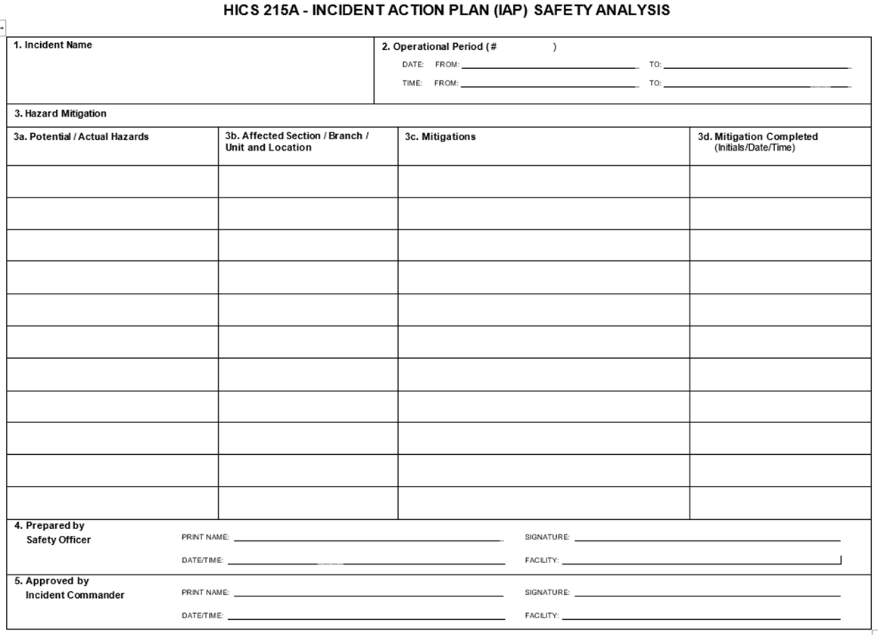

Slide 31
HICS 215 instructions

Slide 32
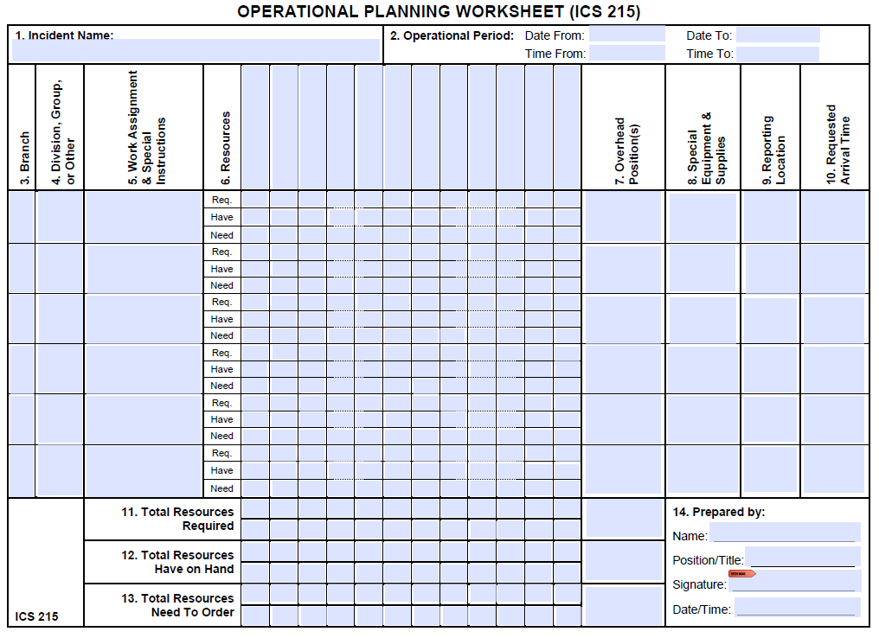

Slide 33
ICS 234-CG instructions

Slide 35
Tactics Meeting
When: Prior to Planning Meeting
Facilitator: PSC
Attendees: PSC, OSC, ISC, LSC, FSC, Resource Unit Leader (RESL), SITL, SOFR, DOCL, COML, Technical Specialist (THSP) as needed
This 30-minute meeting produces operational input needed to support the IAP. The OSC & ISC may present the strategies & tactics for each operational objective (ICS 234-CG) along with the draft work assignments (tactics) & required resources (ICS 215) as well as the proposed Section organization chart. The SOFR will present the Safety Plan (HICS 215a). OSC, ISC, & PSC will solicit input to refine these draft products for full approval at the Planning Meeting

Slide 36
Tactics Meeting Agenda:
PSC brings meeting to order, conducts roll call, covers ground rules, and reviews agenda
SITL reviews the current and projected incident situation
PSC reviews incident operational objectives
OSC reviews the Work Analysis Matrix (ICS 234) strategies & tactics
OSC reviews and/or completes the Operational Planning Worksheet (ICS 215) which addresses work assignments, resource commitments, contingencies, & needed support facilities (e.g., staging area)
OSC reviews and/or completes Operations Section organization chart

Slide 37
Agenda – continued
ISC reviews the Work Analysis Matrix (ICS 234-CG) strategies & Tactics
ISC reviews and/or completes the Operational Planning Worksheet (ICS 215) addressing work assignments, resource commitments, contingencies, & needed support facilities
ISC reviews and/or completes I/I Section organizational chart
PSC validates linkage between tactics & operational objectives
RESL identifies needed tactical resources
SOFR reviews and/or competes the IAP Safety Analysis (HICS 215a) and identifies & resolves critical safety issues
LSC discusses & resolves any logistical issues
FSC discusses & resolves and finance issues
PSC reviews functional task/open actions using the Incident Open Action Tracker (ICS 233-CG)
PSC covers next meeting & planning process assignments

Slide 38
Sample Tactics meeting agenda

Slide 39
General Tasks
Operations
Briefs current operations
Presents strategies, tactics, & resource needs using ICS 215
Identifies alternative strategies
Present Operations Section organization
Planning
Sets up meeting room
Facilitates & documents meeting
Presents current situation & provides projections
Presents resource status
Safety
Identifies potential hazards & recommends mitigation measures
Presents ISC 215
Logistics
Contributes logistics information as necessary
Determines support requirements based on the ISC 215 (e.g., facilities & infrastructure)
Prepares to order resources
Finance/Admin
Contribute finance & administration information as necessary

Slide 40
PREPARING FOR THE PLANNING MEETING
When: Prior to the Planning Meeting
Facilitator: PSC facilitates process
Attendees: None, this is not a meeting, but a period of time
During this phase, the Command & General Staff prepare for the upcoming Planning Meeting. The PSC ensures the material, information, resources, etc., used or discussed in the Planning Meeting are prepared for presentation during the meeting.

Slide 41
General Tasks
Command
Prepares further guidance/clarification
Meets informally with appropriate staff as appropriate
Operations
Prepares ongoing operations update
Prepares final draft of ICS 215
Coordinated with other staff as needed
Finance/Admin
Prepared for Planning Meeting
Verifies financial & Administrative requirements
Planning
Sets up meeting room/space
Develops resources, support, & overhead requests using ICS 213-RR for OSC signature & delivers to Logistics
Publishes & distributes meeting schedule & ensures attendees are prepared
Duplicates documents for Command that are needed to support presentations
Logistics
Orders resources to support IAP
Considers & orders support requirements , including communications, transportation, medical, etc.
Prepares for Planning Meeting
Verifies support requirements

Slide 42
Planning Meeting
When: After the Tactics Meeting
Facilitator: PSC
Attendees: IC/UC, Command Staff, General Staff, SITL, DOCL, COML, THSP
This meeting provides an overview of the tactical plan to achieve Command’s current direction, priorities, & objectives. The OSC presents the plan to the Command & General Staff for review & comment. OSC will discuss the strategies to best meet command’s direction, they will also discuss how the incident will be managed, work assignments, resources & support required to implement the proposed plan. This meeting provides for Command & General Staff to discuss/resolve any issues prior to the PSC assembling the IAP for the next operational period. After review & updates, meeting attendees commit to supporting the plan.
Notes:
THSP – Technical Specialist

Slide 43
Agenda
PSC brings meeting to order, conducts roll call, covers ground rules, & review agenda
IC/UC provides opening remarks
SITL provides briefing on current situation, resources at risk, weather forecast, & incident projections
SOFR provides safety status briefing highlighting any near misses/injuries requiring medical attention beyond basic first aid & any ICP safety issues
PSC reviews Command’s incident priorities, decisions, & objectives
OSC provides briefing on current operations followed by an overview on the proposed plan to include strategies, tactics/work assignments - using the Operational Planning Worksheet (ICS 215), resource commitment, contingencies, Operations Section organization structure, & needed support facilities

Slide 44
Agenda - continued
ISC provides briefing on current operations followed by an overview on the proposed plan including strategies, tactics/work assignments – using the ICS 215, resource commitment, contingencies, I/I Section organization structure, & needed support facilities
PSC reviews proposed plan to ensure that Command’s priorities & operational objectives are met
PSC briefly describes ability to meet all CIRs, as needed
PSC reviews & validates responsibility for any open actions/tasks – using ICS 233, management objectives, & information management plan (if developed)
PSC solicits final input from each Command & General Staff member
LSC covers transport, communications, supply staffing, and resource ordering updates & issues
FSC covers financial issues

Slide 45
Agenda - continued
Public Information Officer (PIO) covers public affairs and public information issues
LOFR covers interagency issues
SOFR covers safety issues
PSC solicits Command & General Staff members commitment to the proposed IAP
PSC requests Command’s approval of the plan as presented. IC/UC may provide final comments
PSC issues assignments to appropriate IMT members for developing IAP support documentation along with deadlines
PSC covers next meeting & planning process assignments

Slide 46
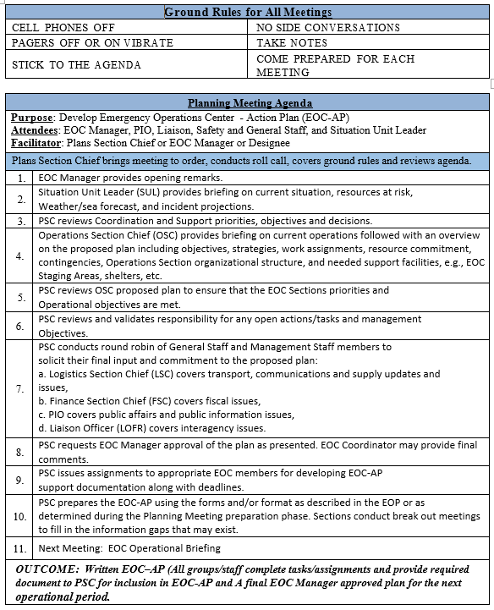
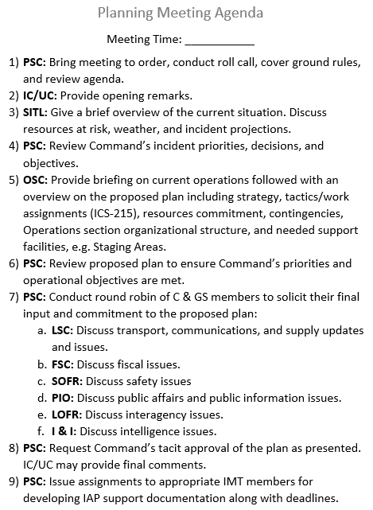
Sample planning meeting agenda

Slide 47
General Tasks
Command
Ensures Command direction, priorities, & objectives have been met
Provides further direction & resolves differences as needed
Gives tacit approval of proposed plan
Operations
Provides overview of current OPS
Presents plan of action, including strategies, tactics, contingencies, resources, organizational structure, & overall management considerations
Planning
Facilitates & documents meeting
Briefs current situation
Provides projections
Logistics
Briefs staffing, logistical support/services, & resource ordering status
Discusses operational facility issues
Finance/Admin
Briefs administrative & financial status/projections
Command staff
Discusses & resolves safety, liaison, and media considerations & issues

Slide 48
Incident action plan preparation & approval
When: Immediately following the Planning Meeting, the PSC assigns the deadline for products
Facilitator: PSC facilitates the process
Attendees: None, this is not a meeting but a period of time
IMT members must complete the assigned task and/or products from the planning meeting that are needed for inclusion in the IAP. These products must meet the deadline as set by the PSC so that the Planning Section can assemble the IAP components. The deadline must be early enough to permit timely IC/UC review, approval, & duplication of enough copies for the Operations Briefing & other IMT members

Slide 49
IAP Common Components & Primary Responsibility
Incident Objectives (HIC 202) PSC
Organizational Assignment List (HICS 203) RESL
Assignment List (HICS 204) RESL
Incident Radio Communications Plan (HICS 205A) COML
Medical Plan (HICS 206) MEDL
Incident Organization Chart (HICS 207) RESL
Incident Map & Chart SITL
Weather Forecast SITL

Slide 50
IAP Optional Components (use as needed)
Command Direction (ICS 202a-CG) PSC
Critical Information Requirements (ICS 202b-GC) PSC
Site Safety & Health Plan (ICS 208) SOFR
Air Operations Summary (ICS 220) AOBD
Demobilization Plan (HICS 221) DMOB
Transportation Plan GSUL
Decontamination Plan THSP
Waste Management/Disposal Plan THSP
Information Management Plan SITL
Traffic Plan GSUL
Volunteer Management Volunteer Coord.
Other Plans and/or documents as required
Notes:
AOBD – Air Operations Branch Director (OSC)
DMOB – Demobilization Unit (PSC)
GSUL – Ground Support Unit Leader (LSC)
THSP – Technical Specialist

Slide 51
Operations briefing
When: Approximately one hour prior to shift change
Facilitator: PSC
Attendee: IC/UC, Command & General Staff, Branch Directors, DIVS, Task Force/Strike Team Leaders (TFL/STL) (if possible), Unit Leaders, others prn
This 30-minute, or less, briefing presents the IAP to the Operations Section oncoming shift supervisors. After this briefing has occurred and during shift change, off-going supervisors should be interviewed by their relief & by the OSC to validate IAP effectiveness. The DIVS may make last minute adjustments to tactics under their purview. Similarly, a supervisor may reallocate resources within that division/Group to adapt to changing conditions
Notes:
DIVS – Division/Group Supervisor

Slide 52
Agenda
PSC opens briefing, covers ground rules, agenda, and takes roll call of Command, General Staff, & Operations personnel required to attend
PSC reviews IC/UC objectives, operational CIRs and changes to the IAP (pen & ink changes)
IC/UC provides remarks
SITL conducts Situation Briefing
OSC discusses current response actions & accomplishments
OSC briefs Operations Section personnel
LSC cover transport, communications, & supply updates
FSC covers fiscal issues
PIO covers public affairs & public information issues
LOFR covers interagency issues
SOFR provides a safety briefing
PSC solicits final comments & adjourns briefing
Notes:
DIVS – Division/Group Supervisor

Slide 53
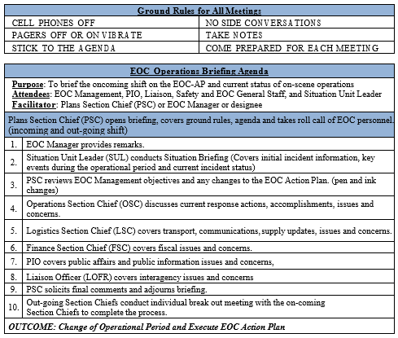
Sample operations briefing agenda

Slide 54
New Operational period begins
Boots on the ground get to work using the new IAP
IC/UC & General Staff Section Chiefs
Catch their breathe
Out-going
Eat & Sleep
In-coming
Formal introductions
Begin to prepare for the IC/UC Develop/Update Objectives Meeting

Slide 55
Assess Progress
Assessment is a continuous activity used to help adjust current operations and help plan for future operations. Following the briefing & shift change, all Command and General Staff Section Chiefs will review the incident response progress and make recommendations to the IC/UC in preparation for the next IC/UC Objectives Meeting. This feedback is continuously gathered from various sources, including Field Observers (FOBS), responder debriefs, stakeholders, etc. IC/UC should encourage Command & General Staff to get out of the ICP and view firsthand the areas of the incident they are supporting.

Slide 56
Special Purpose meetings
These meeting are often necessary and applicable to larger incidents requiring an Operational Period Planning Cycle but can be useful during the Initial Response Phase.
Business Management Meeting
Agency Representative Meeting
Information Strategy Meeting
Media Briefing
Section/Unit Meeting
Antiterrorism & Force Protection (AT/FP) Meeting
Technical Specialist Meeting
Demobilization Planning Meeting
Operational Branch Tactical Planning

Slide 57
Business Management Meeting
This meeting is to develop & update the Business Management Plan for financial & logistical support.
Attendees
FSC, Cost Unit (COST), Procurement Unit Leader (PROC), LSC, SITL, & DOCL
Agenda
Documentation issues
Cost sharing
Cost analysis
Finance requirements
Resource procurement
Financial summary data

Slide 58
Agency Representative Meeting
This meeting is to update AREPs and ensure that they can support the IAP.
Attendees
Led by LOFR
AREPs
Agenda
Usually held shortly after the Planning Meeting in order to present the IAP for the next operational period, this allows for minor changes should the plan not meet the expectations of the AREPs

Slide 59
Information Strategy Meeting
Attendees
IC/UC, PIO, LOFR, PSC, SITL, COML, and any designated deputies for information management
Agenda
This meeting is to establish, revise, & update information management strategies and develop the information management plan.

Slide 60
Media Briefing
This meeting is normally conducted at the Joint Information Center (JIC). All presenters should be prepared by the PIO to address anticipated issues. The briefing should be well planned, organized, and scheduled to meet the media’s needs
Attendees
Set-up by PIO
Moderated by a UC spokesperson
AREPs
Agenda
The purpose is to brief the media and the public on the most current and accurate facts.

Slide 61
Section/Unit Meeting
Attendees
Led by Section Chiefs
Unit Leaders
Agenda
The purpose of this meeting is to keep subordinates (at least down to the unit leader level) informed about IC/UC direction and how the role they play ties into achieving that direction

Slide 62
Antiterrorism & Force Protection (AT/FP) Meeting
The purpose of this meeting is to address physical security measures consistent with current Force Protection Conditions (FPCON). AT/FP meetings are necessary for responses in austere environments resulting from an existing or potential threat.
Attendees
Coordinated by Facilities Unit Leader (FACL)
LSC, Support Branch Supervisors, INTO, OSC, and STAM
Agenda
The FACL or SECM will capture information from the meeting and develop an Incident Security Plan

Slide 63
Technical Specialist Meeting
Attendees
Technical Specialists (THSPs)
Agenda
Gather information from the THSPs for input into the IAP

Slide 64
Demobilization Planning Meeting
The purpose of this meeting is to address Demobilization. At the conclusion of this meeting, the DMOB should be able to prepare a draft Demobilization Plan to include functional requirements of demobilization & distribute the Demobilization Plan to Command, Command Staff, & General Staff for review and comment
Attendees
Command, OSC, PSC, LSC, FSC, LOFR, SOFR, INTO, PIO and DMOB
Agenda
Gather functional requirements needed for the Demobilization Plan from attendees
Notes:
FACL – Facilities Unit Leader – LSC
INTO – Intelligence Officer
STAM – Staging Area Manager

Slide 65
Operational Branch Tactical Planning
Branch Tactical Planning may be needed when:
The incident is so large or complex that there is no single set of objectives that would logically pertain to the entire incident
Special technical expertise is needed for planning
Not feasible to prepare & distribute the IAP within the required timeframe
Need for both classified & un-classified portions of the IAP
Attendees
OSC, PSC, Operations Section Branch Directors
Agenda
Each Branch, with help from planning, will create a HICS 204 for their Branch
All of these individual Branch HICS 204s will get combined by planning for OSC & PSC review and UC/IC approval

Slide 66
QUESTIONS?

Slide 67
Slide Template…
Abc…

