Slide 1
2020 Statewide Full-Scale Exercise Preparation: Anthrax Education
Shawn Stoen, RRC
6 February 2020

Slide 2
Objectives
Discuss what Anthrax is
Identify the treatment parameters for Anthrax
Discuss the means for diagnosing Anthrax
Understand why Anthrax can be a biological weapon
Discuss the necessity for initiating Crisis Standards of Care during a mass event

Slide 3
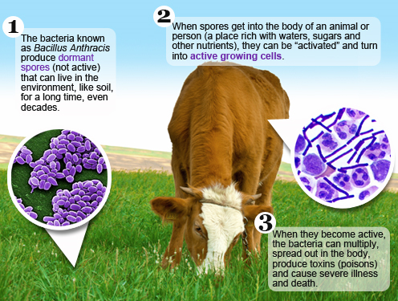

Slide 4
How do people become infected with Anthrax?
Aerosolized/Inhalation
Breath in the spores
Most serious form and can kill quickly if not treated immediately
25% mortality rate with aggressive treatment
Nearly 100% mortality rate without treatment
Ingestion
Eat food or water that is contaminated with the spores
Absorption
Spores come in contact with cuts or scrapes
ANTHRAX IS NOT CONTAGEOUS
Notes:
People at risk include:
Those that work with infected animals or animal products
Eating raw or undercooked meat from infected animals
BIOTERRORISM

Slide 5
Bioterrorism
Anthrax spores are easily found in nature, can be produced in a lab, and can last for a long time in the environment.
Anthrax makes a good weapon because it can be released quietly and without anyone knowing. The microscopic spores could be put into powders, sprays, food, and water. Because they are so small, you may not be able to see, smell, or taste them.
Anthrax has been used as a weapon before.
Bacillus Anthracis – considered a Tier 1 agent as it has the greatest risk of intentional misuse and the highest capability of mass casualty
Notes:
In 2001, powdered anthrax spores were deliberately put into letters that were mailed through the U.S. postal system. Twenty-two people, including 12 mail handlers, got anthrax, and five of these 22 people died.

Slide 6
Anthrax attack
It only takes a small amount of spores to infect a large number of people
Powder/spores in mail (envelopes)
Added to food or water (contaminate water supply)
Released into the air
Via plane, vehicle, elevated surface (air handling)

Slide 7
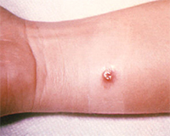
Signs and Symptoms
Cutaneous anthrax symptoms
A group of small blisters or bumps that may itch
Swelling can occur around the sore
A painless skin sore (ulcer) with a black center that appears after the small blisters or bumps
Most often the sore will be on the face, neck, arms, or hands
Injection anthrax symptoms:
Fever and chills
A group of small blisters or bumps that may itch, appearing where the drug was injected
A painless skin sore with a black center that appears after the blisters or bumps
Swelling around the sore
Abscesses deep under the skin or in the muscle where the drug was injected
Notes:
Injection anthrax symptoms are similar to those of cutaneous anthrax, but injection anthrax can spread throughout the body faster and be harder to recognize and treat than cutaneous anthrax.

Slide 8
Signs and symptoms continued:
Inhalation anthrax symptoms
Gastrointestinal anthrax symptoms
Fever and chills
Chest Discomfort
Shortness of breath
Confusion or dizziness
Cough
Nausea, vomiting, or stomach pains
Headache
Sweats (often drenching)
Extreme tiredness
Body aches
Fever and chills
Swelling of neck or neck glands
Sore throat
Painful swallowing
Hoarseness
Nausea and vomiting, especially bloody vomiting
Diarrhea or bloody diarrhea
Headache
Flushing (red face) and red eyes
Stomach pain
Fainting
Swelling of abdomen (stomach)

Slide 9
Anthrax Meningitis
Signs & Symptoms
Severe headache
Altered mental status
Meningeal signs
Other neurological signs
Common complication of anthrax, has a 94% reported fatality rate

Slide 10
Diagnosis
If inhalation anthrax is suspected, chest X-rays or CT scans can confirm if the patient has mediastinal widening or pleural effusion, which are X-ray findings typically seen in patients with inhalation anthrax. The only ways to confirm an Anthrax diagnosis are:
To measure antibodies or toxin in blood
To test directly for Bacillus anthracis in a sample
blood
skin lesion swab
spinal fluid
respiratory secretions
Samples must be taken before the patient begins taking antibiotics for treatment.

Slide 11
Treatment
Antibiotics
Treatment chosen based upon medical history and exam
Post exposure prophylaxis – Doxycycline or Ciprofloxacin
Antitoxins
When spores become ‘activated’ and become toxins the severely ill require antitoxins
This Photo by Unknown Author is licensed under CC BY

Slide 12
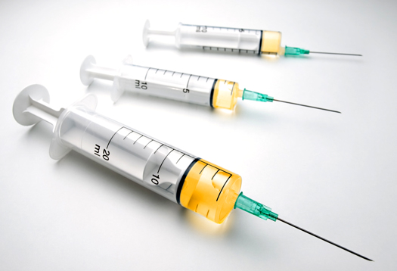
Vaccine
Pre-Exposure Vaccination:
Lab workers that work with anthrax
Some people who work with infected animals (veterinarians)
U.S. Military Personnel
Post Exposure Vaccination:
3 subcutaneous doses of vaccine
Combined with
60 days of antimicrobial prophylaxis
Notes:
Only one vaccine licensed for use for Anthrax in the United States (BioThrax)
93% effective for those that complete the series and maintain the booster vaccination protocol

Slide 13
Crisis Standards of Care
Mass Casualty Event
Provide the greatest good to the greatest number in the shortest time
Patient triage is essential
Divide into two groups :
Suspected Anthrax
Meningitis
Non-meningitis
Non-Anthrax

Slide 14
Notes:
Conventional: The spaces, staff, and supplies used are consistent with daily practices
Contingency: The spaces, staff, and supplies used are not consistent with daily practices, but provide care to a standard that is functionally equivalent to usual patient care practices. These spaces or practices may be used temporarily during a major mass casualty incident or on a more sustained basis during a disaster (when the demands of the incident exceed community resources).
Crisis Levels: Adaptive spaces, staff, and supplies are not consistent with usual standards of care, but provide sufficiency of care in the setting of a catastrophic disaster

Slide 16
Resources
Videos:
https://www.cdc.gov/anthrax/news-multimedia/animations-and-videos.html
CDC
https://www.cdc.gov/anthrax/index.html
Crisis Standards of Care
https://www.health.state.mn.us/communities/ep/surge/crisis/index.html
https://www.health.state.mn.us/communities/ep/surge/crisis/standards.pdf

Slide 17
Next Steps
All Hospitals should train/educate their Command Staff on Anthrax prior to the exercise
Review the Crisis Standards of Care Framework and ensure the Scare Resource Cards are available
Review the role of the coalition in a response
Review the communication streams utilized during an event

