Slide 1
Enhancing Medical Surge Capacity
Melissa Harvey, RN, MSPH
Director, National Healthcare Preparedness Programs

Slide 2
Need for a New Approach to Health Care Emergency Preparedness and Response
Casualty estimates for 21st-century threats (and some old threats) far exceed the capacity and capability of the current health care system
Health care preparedness and response is fragmented and uncoordinated across jurisdictions
Hospitals do not routinely plan, train, or exercise together
Communications during disasters are incomplete
Situational awareness of health care operating status is challenging
State access to federal health care teams and equipment is limited in non-Stafford Act events
National Disaster Medical System (NDMS) and HPP require updating to meet current challenges

Slide 3
Existing Health Care Preparedness Activities
CMS Emergency Preparedness Rule
Hospital Preparedness Program
Effective November 2017
Risk assessment and emergency planning
Policies and procedures
Communications plan
Training and testing
Development of health care coalitions
Two or more hospitals
Public health
Emergency management organizations
Emergency Medical Services (EMS)
2017-2022 Health Care Preparedness and Response Capabilities
Foundation for Health Care and Medical Readiness
Health Care and Medical Response Coordination
Continuity of Health Care Service Delivery
Medical Surge

Slide 4
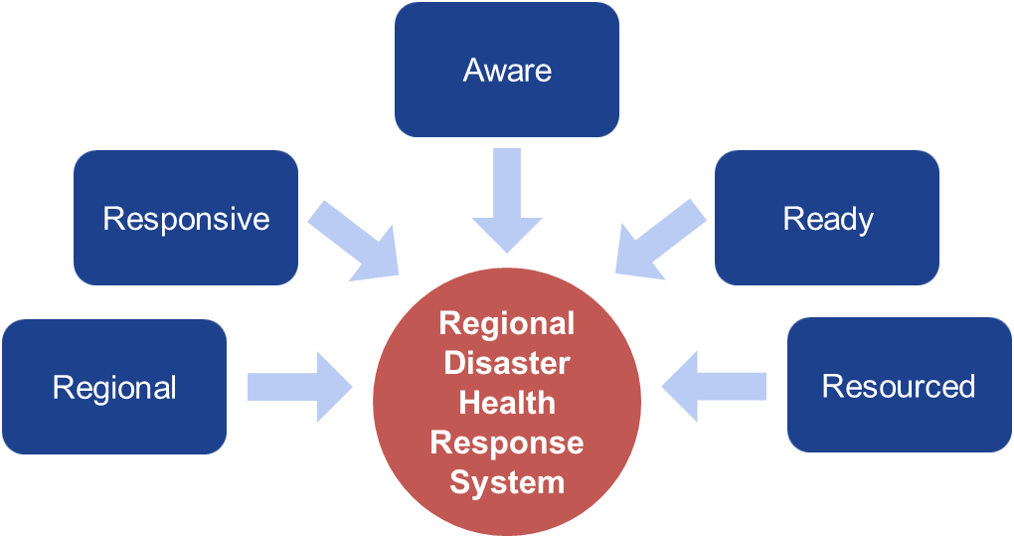
Key Elements of a Potential Regional Disaster Health Response System

Slide 5
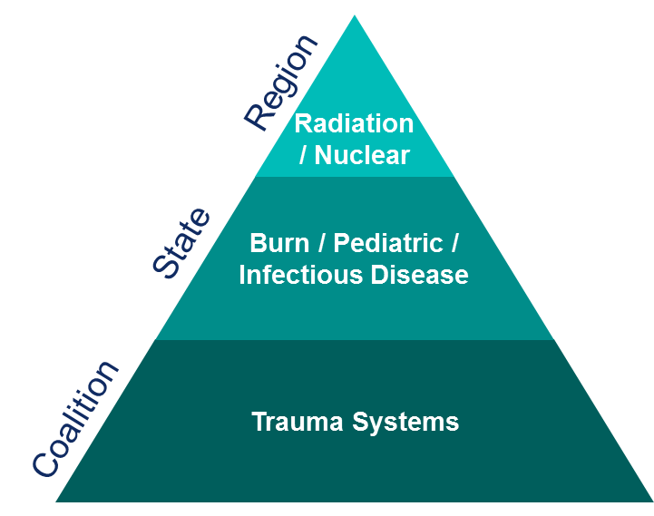
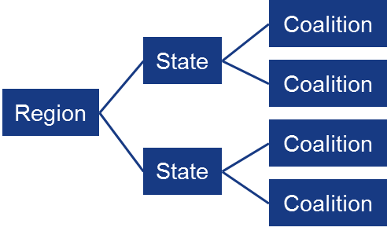
Building Regional Surge Capacity

Slide 6
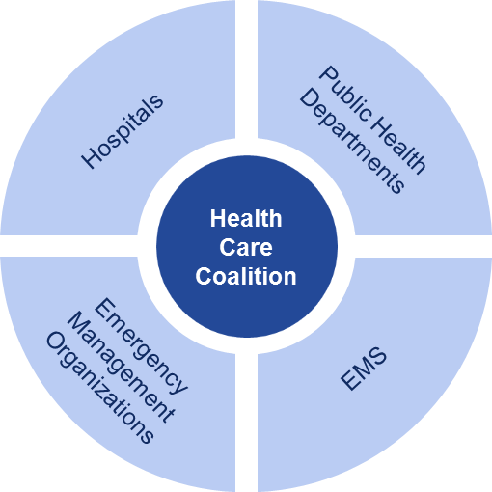
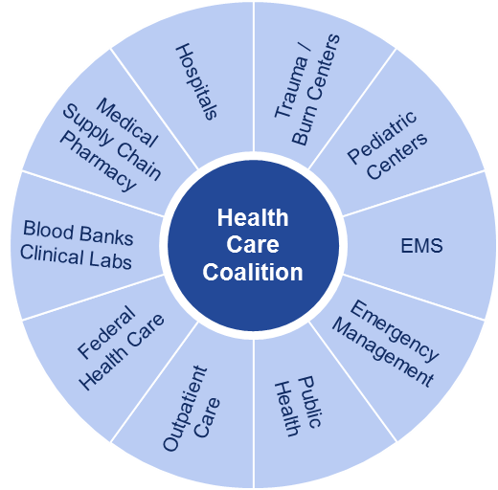
Enhance Health Care Coalitions

Slide 7
Improve Regional Coordination
Regional Structure
Sharing of resources across jurisdictions
Medical EMAC
Common plans, procedures, and policies
Placement of federal resources within the region
Deployment of resources by state governor
Localized centers of excellence that can provide expertise for complicated injuries/illnesses

Slide 8
Expand Response Partners
Responsive
Expand the capacity and capabilities of health care system
Expand NDMS hospital membership to all hospitals
Hospital sponsored Disaster Medical Assistance Teams (DMAT) in each state
Increases response team capacity by ~100%
Increases care capability
Using telemedicine and mobile teams to provide subject matter expertise across the system
Engagement of EMS
Revised engagement of VA and DoD
VA sponsored teams, training
Training of civilian community

Slide 9
Enhance Awareness
Situational Awareness
Collecting and sharing information on a daily basis
Developing essential elements of information for operational decision-making
Regional and state-level operations centers to collect and analyze data
Using databases to assess population health demographics in affected areas to inform response

Slide 10
Ensure Readiness to Respond
Focus on readiness
Readiness standards
Training in chemical, biological, radiological, nuclear, and explosives and in Incident Command System principles
Standardized protocols, procedures, policies
Readiness exercises evaluated by ASPR
Designation as a “Response-Ready” coalition

Slide 11
Improve Federal Programs
Modernization of National Disaster Medical System (NDMS)
Better-trained teams
Hospital-sponsored teams
Incorporation of EMS
Increase number of NDMS hospitals
Integrate the Medical Reserve Corps
Update HPP
Direct funding to entities other than state health departments
Use of risk-based formulas

