Slide 1

Access and Functional Needs – Part 2
Five part series based upon the FEMA Integrating Access and Functional Needs into Emergency Planning – E/L0197 Course material

Slide 2
Welcome
The most important concept for emergency planners is inclusion and integration. Specifically, emergency managers must include people with disabilities in developing, writing, testing, and evaluating all emergency plans to ensure plans include the entire community.

Slide 3
Objectives
Identify appropriate resources to assist in planning for, and with, adults and children with disabilities and access and functional needs related to:
  Communications
  Evacuation
  Transportation

Slide 4
Goals
Today we will focus on:
Operational considerations
Communications
Evacuation
Essential concerns
Rural and remote resources
Community care facilities and organizations
Potential transportation resources
Updating plans

Slide 5
What is Communication Access?
Communication access means providing information in ways that can be:
Understood
Utilized
Trusted
Notes:
The message should be simple - not higher than a third grade reading level. Messages should be tested with a diversity of users for clarity of message (children, people who are deaf, people with cognitive disabilities, etc.).
Communications is always an issue in real events and in exercises…… communication access is the cornerstone of successful planning, response, and recovery; however, it is complex and the least understood of all the areas of inclusive planning, response, and recovery.

Slide 6

Who needs communication access?
People who access communication differently:
See
Hear
Speak
Move
Read
Learn
Remember
Understand

Slide 7
Communication types:
Communication access applies to:
Disaster and local assistance centers
Alerts, warnings, and notifications
Preparedness materials
Call centers
Press conferences

Slide 8
Communication types cont’d
Communication access also applies to:
Social media and websites
Shelters
Radio and television
Printed materials
News articles

Slide 9

Communication redundancy
Announce
Caption
Picture
Email
Relay
Text
Post
Interpret
Repeat
Notes:
Information should be repeated many times. Information needs to be redundant and communicated through different formats so it is received by as many people as possible, as quickly as possible

Slide 10
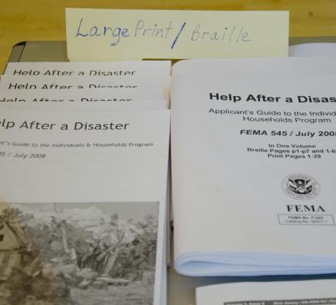
Alternative Formats
Large print
Audio
Electronic
Braille
THINK ABOUT DECON – HOW IS ALTERNATE FORMATS OF COMMUNICATION NECESSARY WHEN DECONING A LARGE DIVERSE POPULATION…..
  Language barriers
Notes:
Alternative Formats
Explain emergency preparedness materials need to be available in alternative formats.
Discuss usable formats in communication access. Alternative formats most likely to be requested include:
Large print: Text produced in Arial or other Sans Serif font. The font will depend on user needs. Consult with the individual.
Audio: Information recorded text on digital records, e.g., iPods, MP3s, and CDs.
Electronic: Text information on CDs
Braille least likely
Please keep in mind these are limited suggestions. Situations may require creativity. Work with the individual to determine the best format.
Some people use alternative means for accessing the web:
Voice input
Alternatives to using a mouse – buttons, etc.
Screen readers – voice output
Mouth sticks and pointers

Slide 11

Emergency Alert System
Officials need to ensure compliance with program accessibility for people with disabilities
Notes:
This includes using resources such as captioning, interpreters, social media
Systems should automatically convert messages to text when a TTY machine is detected

Slide 12
Captioning
Caption press conferences and interviews
Turn captions on for TVs used by public
Include voice reports with flashing news updates
Read emergency scrolling text information
Never block captions with other text
Broadcast messages multiple ways
Notes:
DO THE TV’S IN YOUR HEALTH CARE FACILITIES HAVE CAPTIONING TURNED ON? Example – the TV’s in the waiting rooms

Slide 13
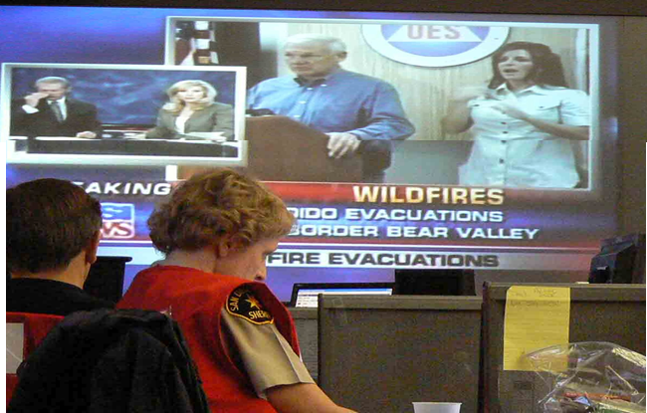
Interpreters
Use during press conferences
Have bilingual staff available
Make sure people know interpreters are available and the times they are available
Notes:
What types of interpreters does your facility use?
Phone
Video Remote interpreters
Do you have a MOU with your interpreter services? If not – make sure you do.

Slide 14

Social Media
Americans are relying more on social media to get their information
Includes web-based and mobile-based technologies used to turn communication into interactive dialogue
Social media DOES NOT replace local alert systems
This Photo by Unknown Author is licensed under CC BY-NC
Notes:
“Social media is becoming an integral part of disaster response. During the record-breaking 2011 spring storm season, people across America alerted the Red Cross to their needs via Facebook. We also used Twitter to connect to thousands of people seeking comfort, and safety information to help get them through the darkest hours of storms.”
- Check in/wellness check ins used in areas that are impacted during disaster.

Slide 15
Public Warnings
Loudspeakers
Picture signs
Notes
Simple sign language signs for emergency workers
  Pain Scale signs
Notes:
This includes using resources such as captioning, interpreters, social media
Systems should automatically convert messages to text when a TTY machine is detected
How many facilities utilize the pain scale symbols in their hospitals now (defining the scale of 1-10 by using images of faces and the levels of grimacing)

Slide 16

The Communications Goal…….
When communication access is planned for, more people get understandable and usable information with fewer unmet communication needs.
This Photo by Unknown Author is licensed under CC BY-NC-SA

Slide 17
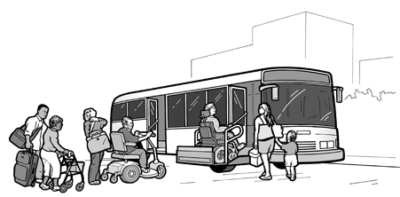
Evacuation/Transportation
Notes:
Approximately 10.8 million out of 110 million (almost 10% of the population) do not drive. In 2000, 77% of Manhattan households did not have a vehicle; In the five New York City boroughs combined, 56% of households did not have a vehicle. Consider the concerns when New York were dealing with 9/11 or the hurricanes where the subway systems were down and transportation assets were cut off.
Emergency planners should consider evacuation and transportation from:
Hazardous areas to safe areas within a jurisdiction
One jurisdiction to another
In health care, we have to consider that evacuation/transportation plans have to focus on ensuring that our patients and our staff are prioritized and have access to transportation

Slide 18
Operational Considerations
Resource identification
Resource coordination
Interagency communication
Operational continuity
Jurisdictional considerations
Leverage existing networks
Notes:
Operational Considerations
No single agency can provide all of the expertise needed for comprehensive planning. An inclusive approach should use expertise from the local individuals, organizations, and agencies. These groups and individuals should be involved in all stages of the planning process. Health care need to work closely with the community partners to identify gaps/needs and resources available – discussion must include prioritization and where those community partners are able to help.
Resource Identification
What accessible transportation resources exist in the community?
How to determine available resources based on impact of specific hazards? (i.e., will assets be lost from areas if flooding, limited access)
Who has priority for using these resources?
Resource Coordination
How to integrate and obtain these transportation resources
Personal assistance services (PAS) – Some people may need assistance during transportation. Does your emergency plan identify resources for drivers who are trained to assist individuals when boarding accessible vehicles? What about individuals who may need PAS in transit?
Interagency Communication
Can transportation resources communicate with each other? How?
How does transportation communicate and coordinate with emergency management, law enforcement and fire?
How will inaccurate information about transportation options be corrected?
Operational Continuity
What services should be maintained the longest and restarted first?
What are the thresholds for suspending transportation services?
What are the protocols and procedures to inform transit users and the community?
Jurisdictional Considerations
There are at least two, and sometimes multiple, jurisdictions with Emergency Operations Plans (EOPs)
It is critical to know what jurisdictions have EOPs to ensure all EOPs are inclusive, meaning they include planning elements for people who have disabilities and other people who have access and/or functional needs.
Does your plan list a resource (ie local bus company) that may be on other agencies lists? Who gets the service first? Need to have these discussions before the emergency.
It is also critical to know in order to make contact with the emergency manager:
Individuals who have disabilities and/or disability service providers should make contact with local emergency managers to offer planning assistance, resource awareness, and subject matter expertise for training and planning.
People with disabilities are a rich resource for emergency planners.
Leveraging Existing Networks
What disability and service support networks exist which might identify and/or provide resources, information and training for emergencies? Possible networks include aging, disabilities, children, veterans, mental health, people experiencing homelessness, etc.

Slide 19
Transportation Considerations
Route designation
Segregation of cars and people
Traffic signal coordination
Intelligent transportation systems
Contra-flow
Notes:
It is important that health care facilities work with locals to identify healths specific needs to access transportation assets – which include discussion about how to ensure that individuals have access to the health care facility……road blocks etc need to ensure that there is access to and from the health care facility.

Slide 20
Concept of Operations
Staging
Embarkation points
Evacuee locations
Care en route
Documentation of evacuees
Procedures for those who do not want to provide information
Notes:
During evacuation it is imperative that plans be made that address access to transportation assets.
Location of staged accessible resources
Embarkation points
Where will evacuees be taken? Where are alternative locations?
Is assistance needed en route? How would you provide assistance for those already on the vehicles? Examples may include those who need personal assistance services, people using oxygen, people with diabetes, and people who have difficulty regulating body temperature.
Documentation to record who was transported and where for all people transported. PATIENT TRACKING
Work out procedures for people who do not want to provide their information.

Slide 21
Service Variation
Service continuity
Temporary service changes
Shelter transportation
Surge capacity
Sustainability
Notes:
Service Continuity: Service continuity decisions have wide-ranging impacts. Reducing tertiary and secondary routes can maximize emergency response capacity. However, this requires inclusive preplanning and communication with clients and transportation officials.
Temporary Service Changes: During and following disasters, temporary and sometimes permanent changes to points of origin and destinations may be necessary. Transit providers may have to adjust their service plan. It may be necessary to allow individuals needing accessible public transportation to access Paratransit and other services, even if they are not registered to use these services in the steady state.
Shelter Transportation: People in emergency shelters may have a higher-than-average dependence on public transportation. Transit planning should ensure adequate accessible transportation is available.
Surge Capacity:
Who might be used to augment regular transit staff? What other accessible forms of transportation exist and what are alternatives?
Who has been trained to operate accessible vehicles, and are contracts in place?
How to provide just-in-time training.
Personal assistance services
Inclusive planning may help government officials become aware of resources and adaptations about which they would otherwise have no knowledge
Sustainability: Developing plans that provide essential personnel rest and recuperation sustains response and recovery operations over multiple operational periods. Transportation agencies should understand the distinction between normal and emergency operations and adapt to these variations

Slide 22
Alert Notification
Staff call-down lists
Client notification systems
Interagency coordination systems
Notes:
Staff Call-down Lists: Develop and maintain accurate call-down lists to mobilize essential personnel. Essential staff are usually put on standby for advance-notice emergencies so they can report for duty quickly. Utilize alternative staffing to assist with mobilizing/transporting patients.
Client Notification Systems: For Paratransit operations, service suspension requires notification of scheduled trips. Many agencies have a phone bank to cancel scheduled customers. Some agencies have evacuation assistance registries to verify evacuation needs. Some Paratransit agencies are developing automated notification systems to notify customers in case of emergency. These systems typically provide emergency details and routing capability. People can be routed to 9-1-1 or other call centers with full accessibility. Texting may be more reliable because less bandwidth is required.
Interagency Coordination Systems: For effective response and recovery, transit must liaison with the Emergency Operations Center (EOC). Communication with the EOC may consist of electronic systems (i.e., Web EOC) and other communication strategies to coordinate response and recovery and avoid service duplication. Memorandums of Understanding (MOUs) should also be established to provide emergency transportation resources.

Slide 23
Essential Concerns
Identify need
Integrate resources
Facility accessibility
Adaptive equipment
Pets/service animals
Accessible transportation
Entering Evacuation Zones

Slide 24

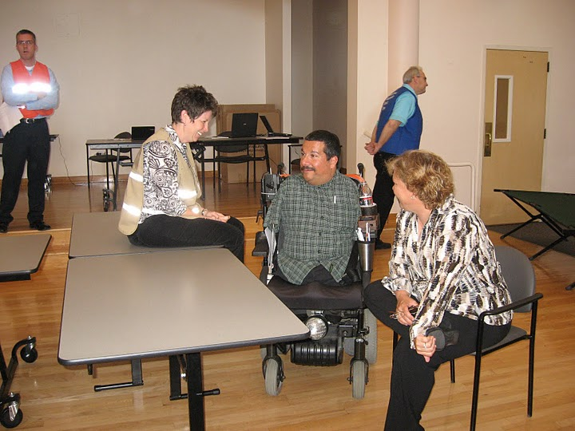




Notes:
When people are able to take their technology and equipment, no or less assistance is needed. People with disabilities can lose their self-sufficiency and become dependent if separated from their mobility device or durable medical equipment.
“When leave my home I leave 70% of my independence.” – Richard Devylder
Padded shower/transfer/commode benches with adjustable arms, legs, and backs -
Photo Credit:
Upper middle http://www.hotfrog.com/Companies/Pediatriceshop-com/Rifton-SoloLift-Patient-Transfer-Lift-29

Slide 25
What community resources can be used to assist with transportation issues?
Notes:
Possible answers include:
State, Territorial, Tribal or Local emergency management agencies
Citizen Corps Councils and Program Partners (Community Emergency Response Teams (CERT), Medical Reserve Corps (MRC), Fire Corps, Volunteers in Police Service (VIPS) and Neighborhood Watch).
Local Emergency Planning Committees (LEPCs)
Local first responders (police, fire, EMT)
Local government and nongovernment disability agencies
Development disabilities networks and service providers
Protection and advocacy agencies
Departments of aging and social services
Hospitals and hospices
Cultural or language-based community groups
VOADs, such as the American Red Cross and the Salvation Army
Health departments
Departments of education
Health and human services agencies (including child welfare)
2-1-1 Human Services Information and Referral Services
HUD or other rent-subsidized multi-family complexes, or otherwise subsidized non-licensed supervised living facilities
Nursing homes
Media
Home healthcare organizations
Medical service and equipment providers (including durable medical equipment providers)
Pharmaceutical providers
Agencies on alcohol and drug addiction
Vocational rehabilitation agencies
Independent living centers
Behavioral health agencies
Commissions on the deaf and hard of hearing and the blind and visually impaired
Translation and interpretation service agencies
Transportation service providers
Utility providers
Colleges and universities
Faith-based organizations
Schools
Local elected officials
Local government transportation officials

Slide 26
Using Service Systems
In-home supportive services
Personal assistance services
Home health
Meals on Wheels
Community-based organizations
Transportation service providers
Centers for independent living
Notes:
Consider the systems available in your community that could assist – do you have agreements/mou with them?

Slide 27
Registries
Concerns about registries are:
Perceived promise or guarantee
Planning is based on individuals always being at home
Tendency to view those on the registry as the only ones who need assistance
Focus on registrants first rather than looking at the population in general
Places unrealistic expectation on first responders
Notes:
Clay county has such a registry
A registry is a database of individuals who voluntarily sign up and meet eligibility requirements for receiving emergency response services based on a need. The concern with registries is:
Some people believe that entering their name and information into a registry means the government will automatically provide transportation or shelter for them in the event in of an emergency. Registrants must understand that being on the registry is not a guarantee of assistance during a disaster, as emergency services may be overwhelmed or even incapable of response due to the disaster.
Many individuals register using their home address, but these people might be at school, work, or elsewhere during the day (making the home address of little use should an emergency occur). Registries should include a question about location of the registrant during daytime hours, but most importantly, registry information must be updated routinely by individuals.
Registries do not identify every individual needing assistance during an emergency; therefore, registries should not be used as a master tool for first responders. Ensure that there are accessible ways for individuals needing assistance to request specific types of assistance during the response.
Registries may focus on registrants first rather than looking at the whole population in general.
Being on a registry may place unrealistic expectations on first responders.
Needs and whereabouts of people are constantly changing. Therefore, keeping a registry updated with accurate information is both continuous and costly and is dependent upon budget for software, personnel, and hardware. Jurisdictions may not be able to afford initial expenditure, upkeep of data, or maintenance of data.

Slide 28
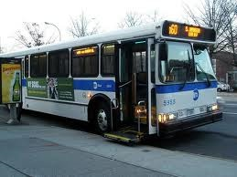
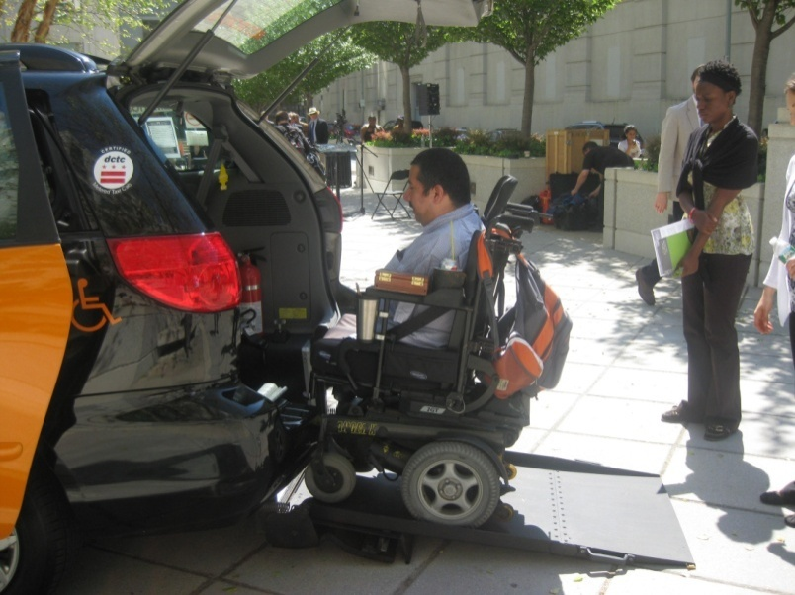
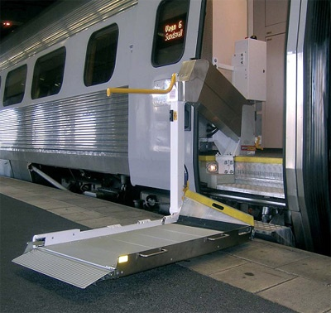
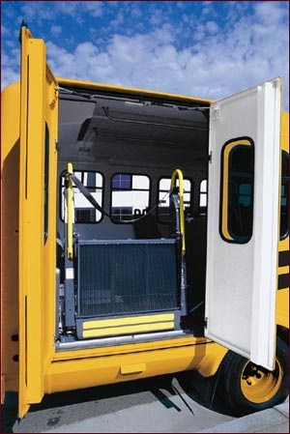
Notes:
Picture upper left – mass transit bus with lift - The plan said, “the main source of transportation during evacuations will most likely be transportation authority buses, that can accommodate up to two wheelchairs each.”
This fails to specifically identify resource capacity and response time. This also ignores the depth of available transportation. Specifics improves response.
Picture upper right – power wheelchair user boarding van with access ramp - Paratransit agencies are an excellent resource to support evacuation. Most paratransit agencies in the U.S. use a variety of transportation assets including vans and taxis.
Private transportation services like taxis, limos, and shuttles must be integrated into response and use cannot solely be dependent on the relationship to paratransit (if one even exists).
Do drivers have authority when evacuating people to relax restrictions.
What communication exists between drivers?
Who are the drivers getting instruction from?
Picture lower left – train with lift - Amtrak and other rail services are a significant and often overlooked evacuation resource.
Picture lower right – school bus with lift - School district transportation is a significant resource, but:
School district transportation resources’ first priority is to students.
School bus drivers often have another job, so may be unavailable a the time of an emergency.
Most school buses are not accessible or have limited wheelchair securement capacity.

Slide 29
Potential Transportation Resources
Paratransit
Public transit
Non-profit organizations
Area agencies on aging
Centers serving people with disabilities
Taxi/limousine services
Non-medical emergency services

Slide 30
Potential Transportation Resources (Continued)
School district transportation systems
Adult day health care (ADHC)
Airport shuttle buses
Airport rental cars
Senior centers
Health care centers

Slide 31
Rural Responses
Emergency preparedness in rural area is just as important as in an urban area.
Neighbors should help each other during a rural response.
Community members develop survival kits for a week or more.
Establish community expectations on when and how government may assist.
Notes:
Rural jurisdictions and agencies, however, are confronted with unique challenges in addressing emergency preparedness. Rural communities, which historically have had limited public health infrastructure, small numbers of providers and volunteer emergency response systems (fire, EMS, police) are considered the most vulnerable and least able to respond.
During emergencies, part of the rural response should be neighbors helping each other. In addition, rural residents should make a survival kit for a week or more. Local officials should provide the entire community with information about local resources, preparation, and best practices, as well as an expectation of when and how government can assist them.

Slide 32
Residential Care Facilities
Should be pre-identified
Evacuation plans must be in place
Includes facilities housing for seniors or people with mental illnesses or developmental disabilities
Notes:
residential care facilities frequently rely on the same transportation resources to evacuate their clients. This may work for a facility evacuation: however this won’t work on a large scale event.
Emergency managers, planners, and public health should meet with the community care facilities to reduce these problems. Plans can be reviewed, and suggestions made for improvement.
A centralized database can also catch resource duplication. Everyone needs to understand the emergency plan. Get residential care facilities to coordinate and plan together.

Slide 33
Mutual Aid
Mutual aid resources may also have transportation concerns:
Equipment/supplies
Shelter personnel
Personal assistance service providers
Notes:
Equipment/supplies: Wheelchairs, shower chairs, canes, hearing aid batteries, diabetic resources, catheters, adult diapers, etc.
Shelter personnel who have access and functional needs or are familiar with people with access and functional needs
Personal assistance service providers

Slide 34
Internal Agreements
Board support
Liability coverage
Staff commitment

Slide 35
Interagency Agreements
Contingency contracts
MOUs

Slide 36

Transportation MOUs
Public entities include:
ADA-mandated paratransit
Dial-a-ride
Fixed-route buses
Community partner vehicles
Shuttles (car rentals, transit hubs)
Rental car/buses
Taxis

Slide 37
MOUs
Roles/responsibilities
Activation
Asset control
Task orders
Liability
Cost recovery
Notes:
Roles/Responsibilities: Clearly defined roles on who provides evacuation assistance for people with access and functional needs.
Activation: How will people be activated, when and by whom?
Asset Control: Who will control and dispatch assets during activation?
Task Orders: How will service requests be received? What is the formal process?
Liability: Whose liability will cover transportation assets (people and equipment)?
Cost Recovery: How, by whom and when will reimbursement be accomplished?

Slide 38
Updating Emergency Plans
What evacuation plans currently exist?
Are multiple entities dependent on the same evacuation resources?
Do your response plans account for movement of individuals from schools, neighborhoods, medical facilities, and nursing facilities?
Notes:
jurisdictional evacuation plans must be reviewed to ensure the availability of sufficient and timely accessible transportation, as well as the mechanisms for requesting this transportation, to evacuate facilities or neighborhoods with a high concentration of residents who need additional assistance. These locations may include:
Schools
Nursing homes
Group homes
Assisted living facilities
Clusters of home-based care clients
Retirement communities

Slide 39
Emergency Plan Review
Are disability and aging transportation providers incorporated into evacuation plans?
Have residential care facilities been identified and mapped?
Do residential care facilities have evacuation plans?
Are transportation service providers incorporated into evacuation plans including aging and disability transportation providers?
Notes:
Do evacuation plans address both accessible transportation needs and a realistic number of alternative resources?
Do you know where people with disabilities and others with access and functional needs access the transit system?
Are written agreements in place with neighboring transportation jurisdictions to assist in emergencies?
Are multiple entities dependent on the same evacuation resources?
How will people with disabilities and others with access and functional needs be transported from schools, neighborhoods, medical facilities and nursing facilities?
Do first responders know the disability and aging transit providers?
Are these providers included in the primary transportation and evacuation plan?
During non-operational hours, how quickly can transportation providers respond?
Are wheelchair accessible vehicles and trained drivers immediately available during evacuations?
Are personal care assistants available to assist people during evacuation, as needed?
Do drills and exercises involve first responders, disability service providers and people with disabilities and other people with access and functional needs?

Slide 40
Emergency Plans (Continued)
Do evacuation plans address areas of the community not served by transit?
Do you know where people with access and functional needs frequently get on your transit system?
Can neighboring transportation jurisdictions assist in emergencies?

Slide 41
Emergency Plans (Continued)
During non-operational hours, how quickly can transportation providers respond?
Do first responders know the disability and aging transit providers?
Are wheelchair accessible vehicles and trained drivers immediately available during evacuations?
Do drills and exercises involve first responders, disability providers, and people with disabilities?

Slide 42
Summary
Communication access is the cornerstone of successful planning, response, and recovery. Information must be understood, utilized, and trusted by the community.
There are many operational considerations that must go into emergency planning for persons with disabilities and access and functional needs.

Slide 43
Summary (Continued)
Rural jurisdictions and agencies are confronted with unique challenges in addressing emergency preparedness.
The identification of available transportation resources and coordination of those limited resources is paramount to an evacuation’s success.
Evacuation plans must be reviewed to ensure the availability of sufficient and timely accessible transportation.

