Slide 1
Access and Functional Needs – Part 1
Five part series based upon the FEMA Integrating Access and Functional Needs into Emergency Planning – E/L0197 Course material

Slide 2
Welcome
“It is time children, people with disabilities, or any other segment of our communities who have traditionally been underserved to be more fully and consistently integrated into preparedness and planning efforts at every level of government.”
Craig Fugate
FEMA Administrator

Slide 3
Objectives
Define access and functional needs and disabilities and how they differ
Define key terms related to inclusive planning
What is C-MIST?

Slide 4
Disability Definition
ADA definition:
Major Life Activities:
The term “individual with a disability” refers to a child or adult who:
Has a physical or mental impairment that substantially limits one or more major life activities
Has a history or record of such an impairment
Is perceived by others as having such an impairment
Caring for oneself
Performing manual tasks
Seeing, hearing, eating, sleeping, walking, standing, lifting, speaking, breathing, learning, communicating, working………

Slide 5
Types of Disability
Developmental/intellectual
Diagnosed before adulthood
Include cerebral palsy, epilepsy, autism, mobility issues
Acquired disabilities
Occur as a result of trauma
Car crashes, falls, sports, violence
Can include damage to brain, spinal cord, hearing, seeing, mobility, memory and learning
Medical Conditions
Includes diabetes, arthritis, asthma, epilepsy, loss of vision
Cognitive
ADHD, dementia, PTSD
Notes:
These limitations can range in type and duration. Can be partial or total, temporary or permanent, and mild or catastrophic.

Slide 6
Access and Functional Needs definition
Individuals with different cultures, races, and nations of origin
Individuals that do not read, limited English proficiency, or non-English speaking
Individuals that have developmental/intellectual, acquired, cognitive, or medical disabilities
Older adults with and without disabilities
Children with and without disabilities AND their parents
Individuals with economical or transportation needs
Pregnant women
Individuals with chronic medical conditions
Individuals that are dependent on pharmaceuticals
Social/service organizations that serve any of the listed groups
Notes:
FEMA wants to ensure that the ‘whole’ community has equal access and ability to participate.
Pharmaceutical dependent – include pain medications, insulin, oxygen, C-Pap device, - any prescriptions or over the counter medications on a regular basis
Include those that require durable medical equipment such as hearing aides, walkers, canes, wheelchairs etc.

Slide 7
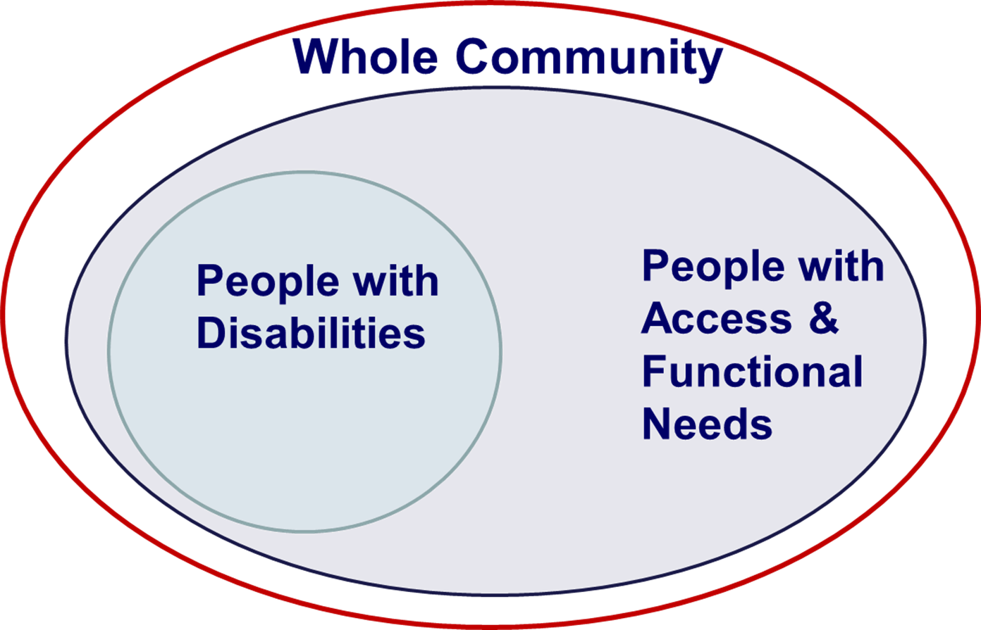
Inclusive Planning
Planning efforts that include ALL people with access and functional needs will leave no one behind.
If you focus on just those with disabilities then you risk the chance of not planning for ALL

Slide 8
Plans Must Have:
ALL must have access to all programs, services and activities – without restriction
Location must be accessible to all
Access to transportation assistance 24/7
Effective communication – must be given the same information – content/detail that is given to the general public
Example: phone service/access for deaf
Must not be charged to cover the costs of measures necessary to ensure equal access
Example: interpretive services are provided at no cost
Notes:
The key concepts to be compliant are:
Equal access
Programmatic
Physical
Effective Communication
Inclusion
Integration
No charge

Slide 9
C-MIST
Communication
Maintaining Health
Independence
Safety, support, and self-determination
Transportation and evacuation

Slide 10
Programmatic Access
People with disabilities must be able to access the same programs and services as the general population. Access may include modifications to:
Programs
Policies
Procedures

Slide 11
Physical Access
People with disabilities must be able to access locations where emergency programs and services are provided.
Architecture
Equipment

Slide 12
Effective Communication
Effective communication includes:
Information about alternate formats
Auxiliary aids and services
508 compliance
All information should be able to be read by all supporting communications aides – i.e. text to talk, talk to text, braille
This includes computer based information

Slide 13
Good practices:
Planning is about integration.
Never separate planning to address access and functional needs.
Be specific about roles and responsibilities.
Work together and work smart.
Consistent and active engagement and involvement in all aspects of planning
Notes:
It is all about inclusion. Incorporate at risk populations in all plans. Good idea to have plans reviewed to ensure that plans are all-inclusive

Slide 14
What Inclusive Planning does:
Understanding community complexity
Recognizing community capabilities and needs
Fostering relationships with community leaders
Building and maintaining partnerships
Empowering local action
Leveraging and strengthening the social infrastructure, networks, and assets

Slide 15
Summary
Currently, 20% of the U.S. population has a disability, and everyone has access and functional needs at one time or another.
Persons with disabilities are a protected class.
The five needs to incorporate in emergency planning can be remembered by the acronym C-MIST .
A strategic emergency plan should contain objectives of what should be accomplished.

Slide 16
The key concepts to comply with disability civil rights laws are equal access inclusion, integration, and no additional charge for the cost to ensure equal access and nondiscriminatory treatment.
Whole community planning looks beyond the traditional government-centric approach to emergency planning to understand and meet the actual needs of the community.

Slide 17
Discussion/Questions
Take this time to discuss who in your community would be good partners to include in your preparedness planning discussions?
What resources are available to your agency and do you include them in your planning efforts?

