Slide 1
CMHPC exercise plan
May 2019 ASPR & July 2019 Surge Exercise Overview

Slide 2
Key concepts
May 17th, 2019 ASPR CST (0930-1200)
Little Notice
EMERGENT 20% Evacuation of total coalition hospital beds
Per average daily census information a week prior
Multiple facilities spread across the region will need to evacuate to make up the numbers needed
All other facilities will need to surge
Hospitals (non-evacuating)
LTC/SNF
D/C to Home
Home Health/Hospice
Community Paramedic/EMT
Possible information to LPH?
July 25th, 2019 (0930-1200)
Hospital ED Surge (every facility)
Off load ED
In-Patient Units
Med/Surge Units
Critical Care Units
LTC/SNF
From ED
Med/Surge Hospital Units
D/C to Home
Home Health
Hospice
Community Paramedic/EMT
LPH
How does a community disaster affect LPH and their patients in-home
Electricity
Water

Slide 3
May 2019 aspr cst
How do we get 20% of coalition hospital average daily census?
Incorporate multiple facilities
Key locations to stem a complete HC response
Central, NW, NE, West, & East
1-2 facilities per “area” to Evacuate
3-4 facilities (hospital) Surge to accommodate the evacuation of neighboring facilities
Multiple other key Health Care facilities Surge as well to assist
These facilities will need to be contacted prior to get a commitment for response PRN
Each hospital should make contact and alert; get a verbal commitment for day of response
Even if don’t evacuate, if you have an agreement, the evacuation hospital in your area could surge to them, or you could off load some of your patients to make room for the evacuated patients
These would include any of the following as previously described
Notes:
Tri-County – Evac to CCH-LP, Lakewood, SCH
CCH-Paynesville – Evac to CCH-SC, CCH-Melrose, SCH
Essentia Health-SJMC – Evac to CRMC, CHI-St. Gabriel’s, Riverwood, SCH
First Light Health – Evac to Mille Lacs Health, Essentia Health-Pine Medical Center, CMC, SCH
CCH-Mont – Evac to Buffalo, NMC, FLMC, SCH

Slide 4
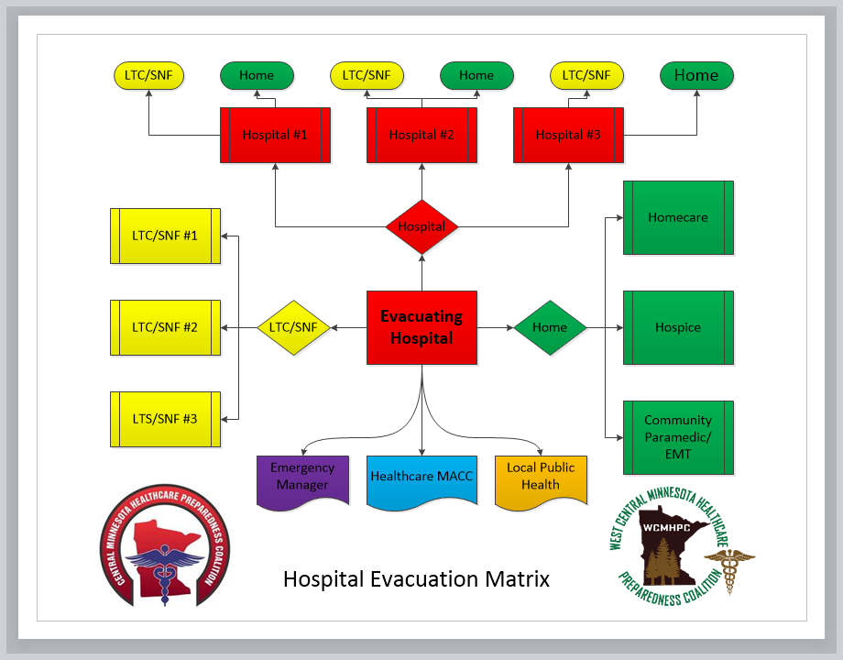
Hospital Evacuation Matrix

Slide 5
July 2019 ED Surge test
How well will our ED’s do with a surge that resembles their MNTrac MCI values
Incorporate multiple HC facilities/entities
Every ED will receive a significant surge over about 90 minutes
Time “0” – Notification & “Dump”
Time “15” – 1st round of patients (25%)
Time “30” – 2nd round of patients (30%)
Time “45” – 3rd round of patients (30%)
Time “60” – 4th round of patients (15%)
Time “75” – End of ED play
Time “90” – EndEx/Start Hotwash
Multiple other key Health Care facilities Surge as well to assist
These facilities will need to be contacted prior to get a commitment for response PRN
Each hospital should make contact and alert; get a verbal commitment for day of response
These would include any of the following as previously described
Notes:
Tri-County – Evac to CCH-LP, Lakewood, SCH
CCH-Paynesville – Evac to CCH-SC, CCH-Melrose, SCH
Essentia Health-SJMC – Evac to CRMC, CHI-St. Gabriel’s, Riverwood, SCH
First Light Health – Evac to Mille Lacs Health, Essentia Health-Pine Medical Center, CMC, SCH
CCH-Mont – Evac to Buffalo, NMC, FLMC, SCH

Slide 6
MNTrac MCI numbers
MN State Trauma Designation
Level II ~50
Red ~10
Yellow ~15
Green ~25
Level III ~27
Red ~4
Yellow ~8
Green ~15
Level IV ~16
Red ~2
Yellow ~4
Green ~10
Potential Arrival rates
Level II ~50-75
15” ~13-19
30” & 45” ~15-23
60” ~8-11
Level III ~27-40
15” ~7-10
30” & 45” ~8-12
60” ~4-6
Level IV ~16-24
15” ~4-6
30” & 45” ~5-7
60” ~2-4

Slide 7
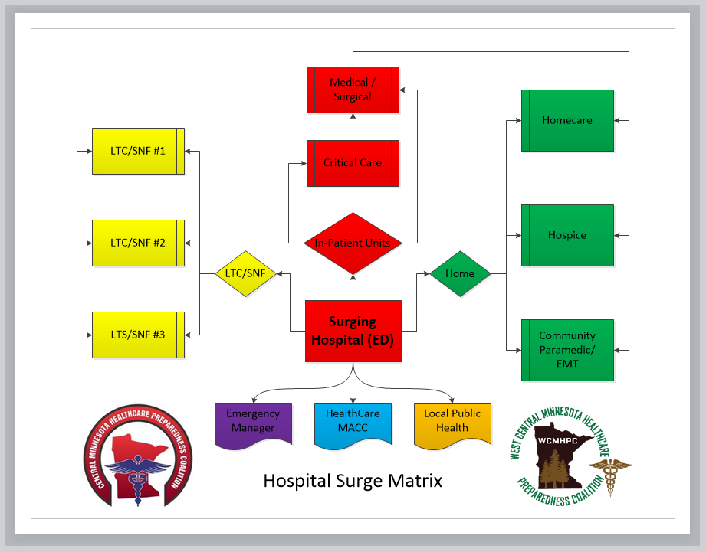
Hospital Surge Matrix

