Slide 1
ASPR Coalition Surge Test
Let’s evacuate 20% of our coalition hospital patients, in 90 minutes…

Slide 2
An Exercise for Assessing and Improving Health Care Coalition Readiness
The Coalition Surge Test (CST) includes a user-friendly peer assessment low/no-notice exercise that helps health care coalitions identify gaps in their surge planning. Low/no-notice exercising is important in assuring that health care coalitions can transition quickly and efficiently into “disaster mode” and provide a more realistic picture of readiness than pre-announced exercises. The exercise is designed to be challenging and is intended to support continuous improvement.
The audience for this document is the small assessment team that plans and administers the CST and a “trusted insider” (i.e., a member of the assessed coalition who agrees to assist in planning). Because of the nature of low/no-notice exercises, the players will receive most of their instructions from the assessment team on the day of the CST.

Slide 3
Introduction
Phase I
At ~T=-60 minutes, the evacuating facilities will be notified that they have approximately 2 ½ - 3 hours to EMERGENTLY Evacuate their facility.
This includes finding an accepting facility and gaining transport for their patients
At T=0, the exercise begins with all facilities participating. The evacuating facilities can begin to communicate with accepting facilities and transferring agencies to plan for patient movement.
No real patients will be moved, this is a paper patient exercise.
Evacuating Facilities will complete the CST EVAC TOOL
T=0 – T=90, For the next 90 minutes, the coalition partners will work to move the required 20%. At the end of 90 minutes, the exercise will halt.

Slide 4
Evacuating Facilities…
At T-60, the evacuating facilities will need to assess their current situation & set up a command center to prepare for the evacuation that will begin @ T=0
“What is your current Patient census?”
List out the type of pt.
Med/Surge
ICU
Peds
L & D
Psych
“How many Patients did you send home rather than evacuate?
CST EVAC Tool_17May2019
“Preparation” – TAB
Line #31

Slide 6
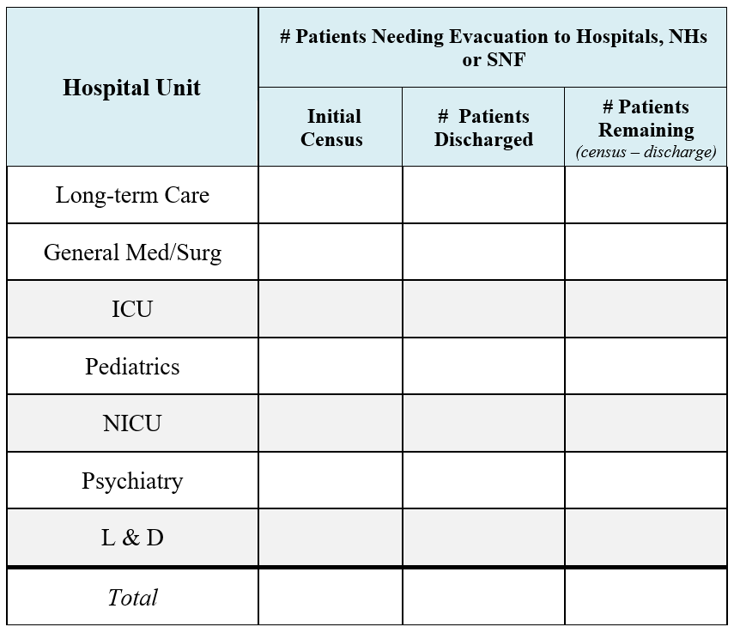
P
R
E
-
E
V
A
C
U
A
T
I
O
N
A
S
S
M
E
N
T

Slide 7
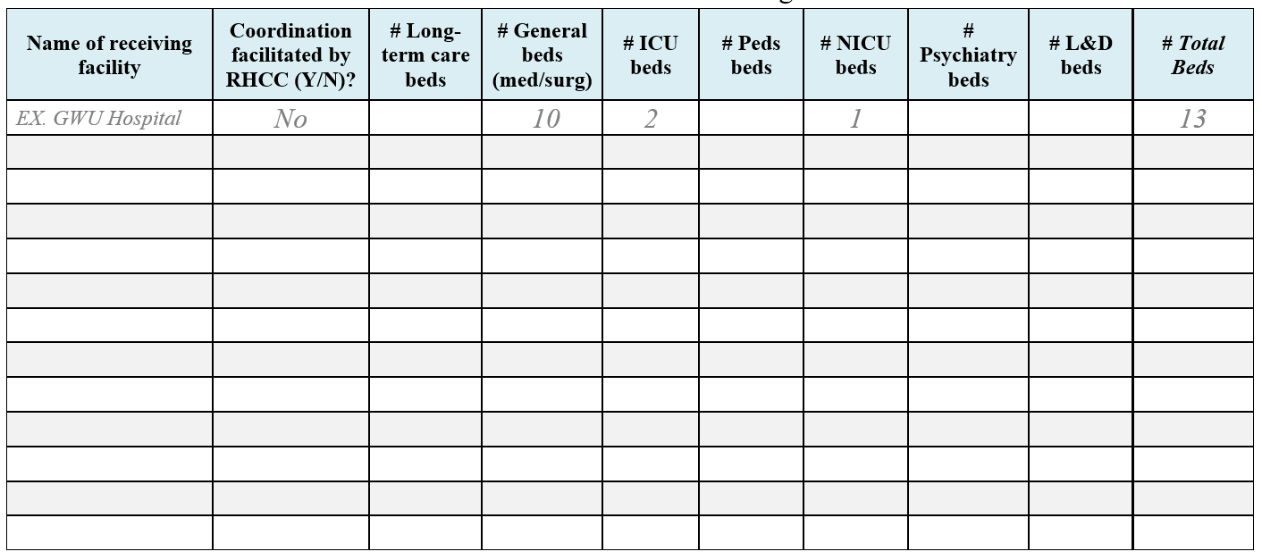
Patient Evacuation Tally Sheet for Evacuating Facilities

Slide 8
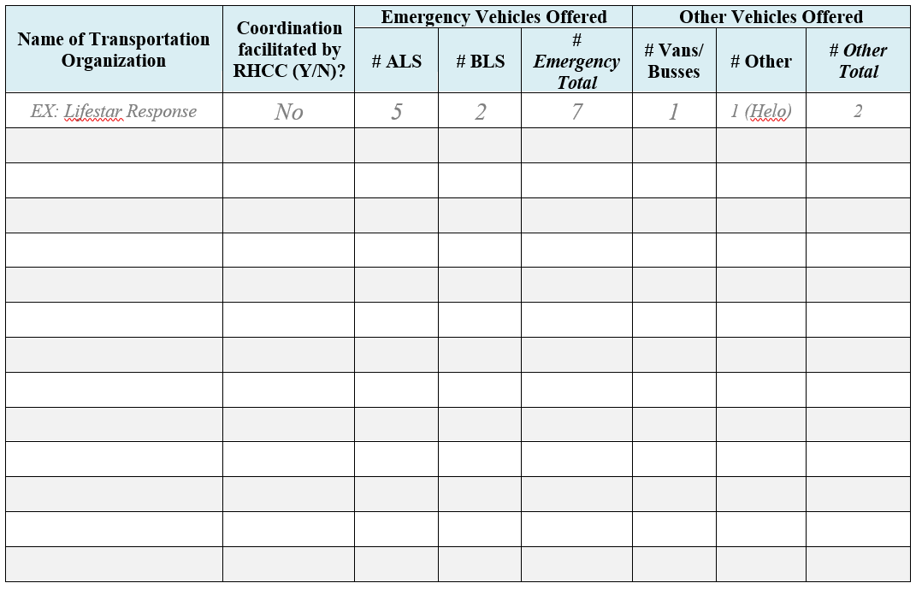
Transportation Arrangements for Evacuated Patients

Slide 9
Evacuation Begins…
At T=0, the evacuating facilities will take the information & numbers obtained in the past 60 minutes and begin to arrange transfer and transportation.
“How many ambulances do you need?”
Each trip counts as 1 ambulance
Ambulance “A” goes 20 miles, drops 2 patients, comes back, goes 30 miles, drops 2 patients
Ambulance “A” counts as 2 ambulances due to performing 2 trips during the event
How many minutes did it take to get the last patient a ride arranged?

Slide 10
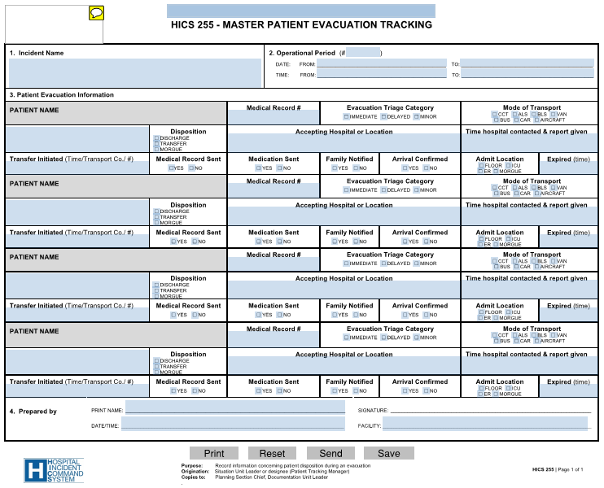
How might you track outgoing patients…HICS Form #255

Slide 11
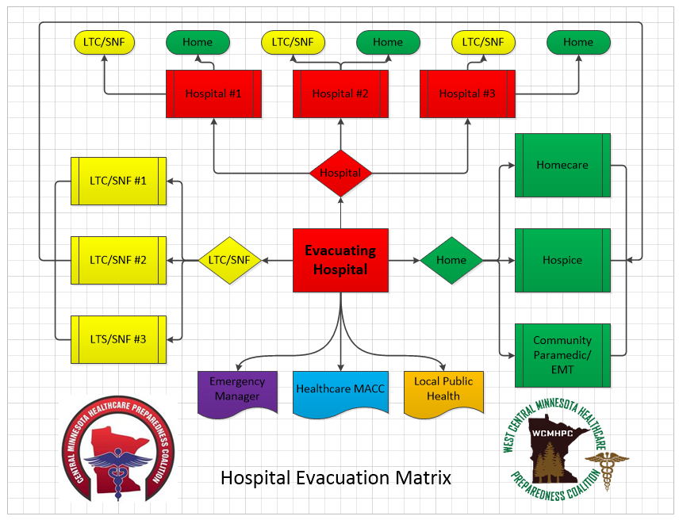

Slide 12
Surge Hospital and Facilities…
At T=0, the evacuating facilities will begin to reach out to other coalition facilities in an attempt to find beds for their patients. Surging facilities will need to assess their current situation & set up a command center (if needed) to prepare for the surge.
“How might you track the incoming phone calls regarding pt. transfers to your facility?”
HICS #254
NHICS #254

Slide 13
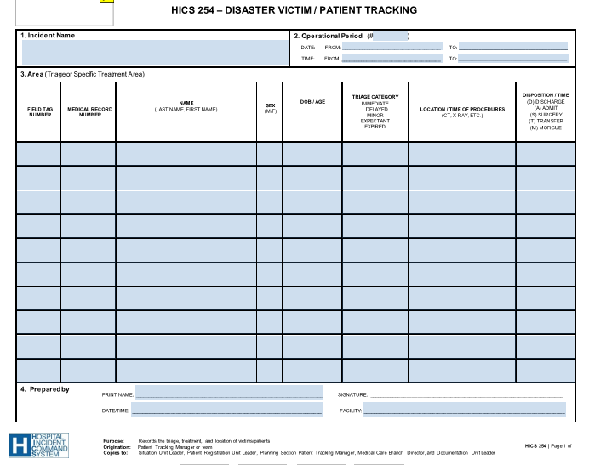

Slide 14
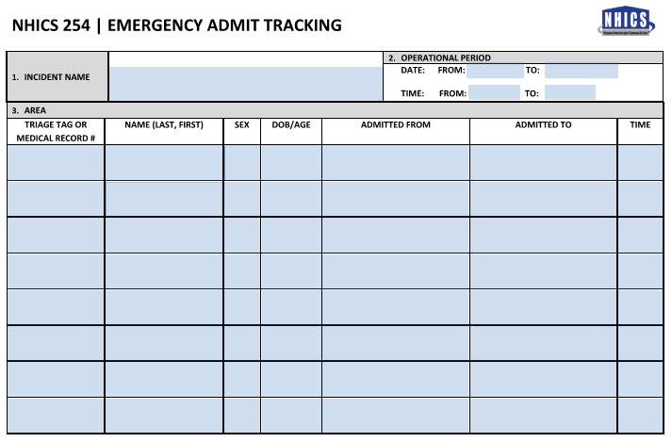

Slide 15
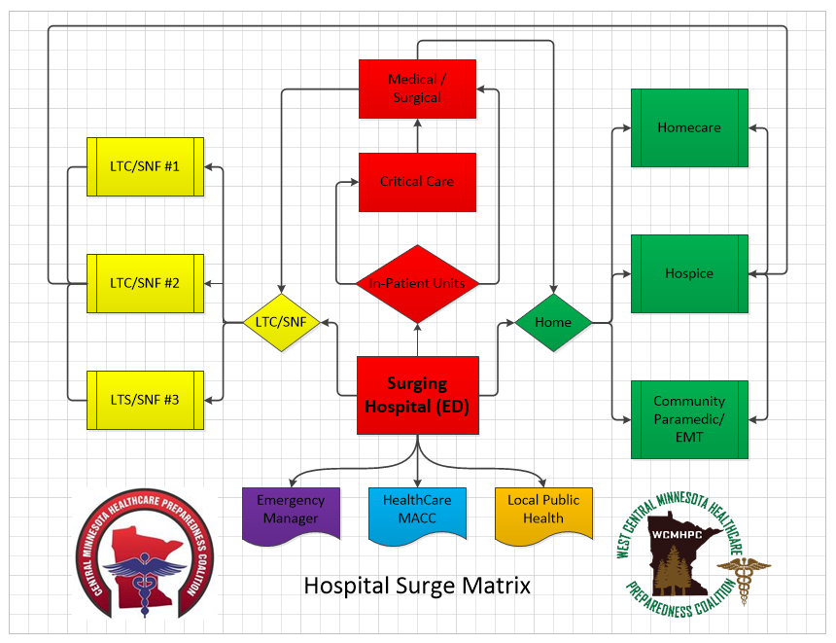

Slide 16
Discussion after to compile the data…
We will take the data compiled from the documents that are completed by the evacuating facilities and see how we did…
How many patients did we need to move?
How many patients did we move?
How many ambulances does it take?
Can EMS keep up with the request?
How did we do?

