Slide 1
CMHPC exercise plan
Evacuation - vs - Surge

Slide 2
Key concepts
ASPR CST – May 2019
Little Notice
EMERGENT 20% Evacuation of total coalition hospital beds
Per average daily census information a week prior
Multiple facilities spread across the region will need to evacuate to make up the numbers needed
All other facilities will need to surge
Hospitals (non-evacuating)
LTC/SNF
D/C to Home
Home Health/Hospice
Community Paramedic/EMT
Possible information to LPH?
Hospital ED Surge – July 2019
Off load ED
In-Patient Units
Med/Surge Units
Critical Care Units
LTC/SNF
From ED
Med/Surge Hospital Units
D/C to Home
Home Health
Hospice
Community Paramedic/EMT
LPH
How does a community disaster affect LPH and their patients in-home
Electricity
Water

Slide 3
May 2019 aspr cst
How do we get 20% of coalition hospital average daily census?
Incorporate multiple facilities
Key locations to stem a complete HC response
Multiple other key Health Care facilities Surge as well to assist
These facilities will need to be contacted prior to get a commitment for response PRN
Each hospital should make contact and alert; get a verbal commitment for day of response
Even if don’t evacuate, if you have an agreement, the evacuation hospital in your area could surge to them, or you could off load some of your patients to make room for the evacuated patients
These would include any of the following as previously described
Notes:
Tri-County – Evac to CCH-LP, Lakewood, SCH
CCH-Paynesville – Evac to CCH-SC, CCH-Melrose, SCH
Essentia Health-SJMC – Evac to CRMC, CHI-St. Gabriel’s, Riverwood, SCH
First Light Health – Evac to Mille Lacs Health, Essentia Health-Pine Medical Center, CMC, SCH
CCH-Mont – Evac to Buffalo, NMC, FLMC, SCH

Slide 4
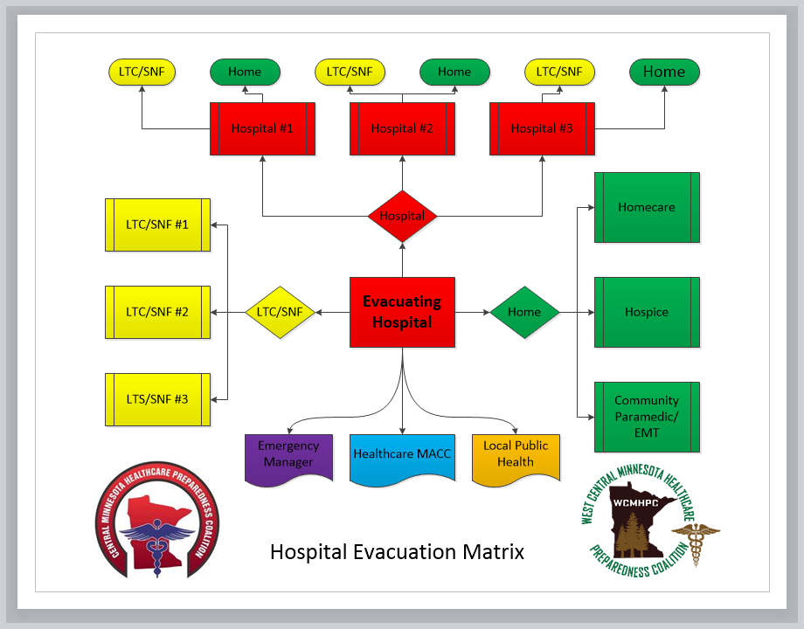
Hospital Evacuation Matrix

Slide 5
ED Surge test – July 2019
How well will our ED’s do with a surge that resembles ½ of their total licensed beds?
Incorporate multiple HC facilities/entities
Every ED will receive a significant surge over about 75 minutes
Time “-30” – Set-up & Prep
Time “0” – Notification & “Dump”
Time “15” – 1st round of patients (8%)
Time “30” – 2nd round of patients (22%)
Time “45” – 3rd round of patients (34%)
Time “60” – 4th round of patients (36%)
Time “75” – End of ED play
Time “90” – EndEx/Start Hotwash
Multiple other key Health Care facilities Surge as well to assist
These facilities will need to be contacted prior to get a commitment for response PRN
Each hospital should make contact and alert; get a verbal commitment for day of response
These would include any of the following as previously described
Notes:
Tri-County – Evac to CCH-LP, Lakewood, SCH
CCH-Paynesville – Evac to CCH-SC, CCH-Melrose, SCH
Essentia Health-SJMC – Evac to CRMC, CHI-St. Gabriel’s, Riverwood, SCH
First Light Health – Evac to Mille Lacs Health, Essentia Health-Pine Medical Center, CMC, SCH
CCH-Mont – Evac to Buffalo, NMC, FLMC, SCH

Slide 6
½ of your licensed beds
Critical Access Hospital
Typically level 3 or 4 Trauma Designation
Usually about 20-25 beds
You should plan to receive ~13 patients over 1 hour in 4 deliveries
Larger facility
Typically level 2 or 3 trauma designation
Usually 50-500 beds
You should plan for about ~25-250 patients over 1 hour in 4 deliveries
Green = 68%, Yellow = 18%, & Red = 14%

Slide 7
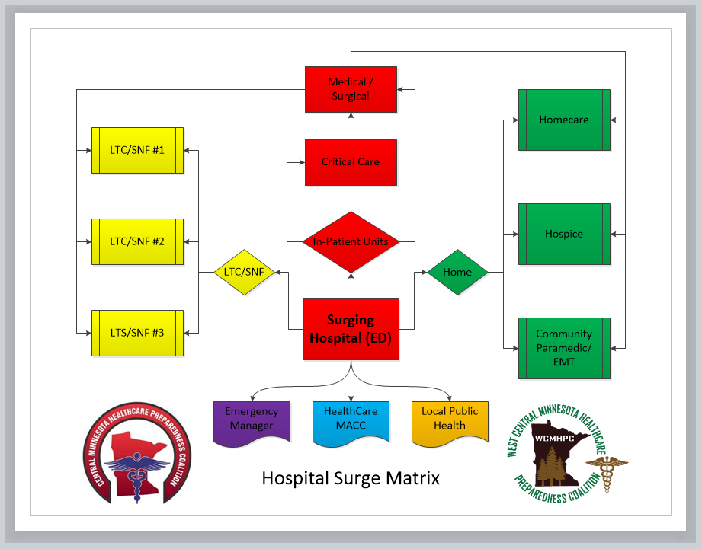
Hospital Surge Matrix

Slide 8
Exercise controller roles & responsibilities
Roles and Responsibilities of the “Controller”
You are the leader of a four-person exercise team (you can be one of the below listed)
ED Exercise Controller (ED Exercise Controller Tool & Arrival List Generator)
ED Qualitative Evaluator (optional)(ED Qualitative Tool)(assist ED Controller prn)
Incident Command Evaluator (Command Center IC Tool)
Bed Controller Evaluator (IC Bed Controller Tool)
Each will need a laptop computer with Excel capabilities as listed above
ED will need a Laptop as well with Excel (Arrival List Generator, if not part of ED Controller)
Read or view the surge-test-hospital document/pdf

Slide 9
Who goes where…
Red surge patients will require an ICU bed or Operating Room after stabilization in the ED
Yellow surge patients will require a medical/surgical bed after stabilization in the ED
Green surge patients will not require an ED bed as they will be treated in an alternative location and discharged home.
Current ED patients can go to ICU, Med/Surg, or D/C to LTC/SNF or Home
Current ICU can go to Med/Surg
Current Med/Surg can be D/C to LTC/SNF or Home

Slide 10
Hospital staffing for exercise
Command Center
Incident Command Staff (1)
Lead the event
Nursing Supervisor/Bed Controller (1)
Control the flow of patients to the floor, ICU – vs – med/surg.
Emergency Department
ED Provider (MD/NP/PA) (1)
Control admissions & discharges from ED
ED Charge RN (1)
Control beds in the ED
Admissions and discharges
If the facility wishes to have others assist, that is completely fine as well

Slide 11
ED Controller
30 minutes prior to start
“START EXERCISE” tab
Read overview and review the instructions
Time = Zero (0)
Click on the “START EXERCISE” tab, then click on the “T=0 to T=15” tab
Time = 0-15, 15-30, 30-45, 45-60, & 60-75
Read Script to “Provider & RN”
Input all data as requested and created by the facilities actions
Read exactly as scripted
Fill in all data as it is given to you by “Provider & RN”
Conduct a Hotwash with all players, share information on the “HOTWASH” tab

Slide 12
ED Controller
All incoming patients should be entered into a patient tracking system
If patients are transferred out of the ED, not admitted to the floor/ICU, they should be tracked as well
This could be to their home (w/family, Home Care, Hospice, Community Paramedic/EMT, LTC/SNF, or another facility…

Slide 13
View ED Exercise Controller Tool.example

Slide 14
Command Center bed controller
30 minutes prior to start
“START EXERCISE” tab
Read overview and review the instructions
Time = Zero (0)
Enter the data required on the “START EXERCISE” tab
Describe the flow to the Nursing Supervisor/Bed Controller
Time = 0-15, 15-30, 30-45, 45-60, & 60-75
Enter the data from the Nursing Supervisor/Bed Controller in the “ICU” & “FLOOR” tabs as it is determined
Conduct a Hotwash with all players, share information on the “HOTWASH” tab

Slide 15
Command Center bed controller
All outgoing patients should be entered into a patient tracking system
This could be to their home (w/family, Home Care, Hospice, Community Paramedic/EMT, LTC/SNF, or another facility…

Slide 16
View Command Center Bed Controller Tool.example

Slide 17
Command Center IC evaluator
30 minutes prior to start
“START HCC EXERCISE” tab
Read overview and review the instructions
Time = Zero (0)
Click on the “START EXERCISE” button
Read the script exactly as written aloud to the IC
Select the “Staff & Supplies” Tab
Enter the data required as obtained by the IC
Time = 0-15, 15-30, 30-45, 45-60, & 60-75
Watch how the IC & Nursing Supervisor/Bed Controller interact and function
Conduct a Hotwash with all players, share information on the “HOTWASH” tab

Slide 18
View Command Center Incident Commander Tool.example

Slide 19
Hotwash…
Each of the four controllers will meet with the staff that participated in the exercise and share their thoughts and findings.
The controllers will follow the “HOTWASH” tab instructions and flow to gain information pertinent to the hotwash.
Staff will be asked to answer the questions and the controllers should record their responses.

Slide 20
Summary
3-4 Controllers
4-5 Laptops/Computers with Excel capability
4+ Staff to participate in the exercise for 120 minutes
Meet 30 minutes prior to start of exercise to preview the Excel documents
Lead Controller should read the “surge-test-hospital” pdf prior to the day of the exercise.
Surge should test the facility to a level of approximately ½ of their licensed bed capacity in a surge setting.
Licensed for 25, will receive 13 (1, 3, 4, 5) – or – (1 red, 2 yellow, & 10 green)
Licensed for 100, will receive 50 (4, 11, 17, 18) – (7 red, 9 yellow, & 34 green)
Licensed for 400, will receive 200 (16, 44, 68, 72) – (28 red, 36 yellow, 136 green)

Slide 21
Summary continued
No real patients will move, this is 100% simulated.
Patients already in the system should utilize their real D.O.B with a fictious name
Patients that are surged to the ED will need a random name assigned with D.O.B.
A list of names and D.O.B. will be emailed to the ED Controller prior to the exercise date.

